Slide 1
Introduction to Logistic Regression

Slide 2
Introduction
In earlier lectures, we considered problems where the dependent variable Y was continuous (and ideally normal)
But what if Y is binary?
Yes/No
True/False
Pass/Fail (e.g., building code inspection)
Presence/absence of a crime, park, building feature, bike lane, etc.
Notation: Yes, True, Pass, Presence = 1 and No, False, Fail, Absence = 0
That is, like in multiple regression, we want to see the extent to which Y might be associated with predictors x₁… x_{k}.

Slide 3
Introduction (Cont’d)
Assume Y is a binary variable representing the presence of a hospital in a zip code.
1=there’s a hospital, 0=there’s no hospital
In that case, P(Y=1) is the probability that Y takes on the value 1.
Assume further that Y depends on a number of factors
x₁: Population of zip code (in 1000’s of people)
x₂: Presence of a hospital in any of the nearby zip codes
x₃: Whether zip code is urban (1) or not (0)
For now, let’s focus just on x₁.

Slide 4
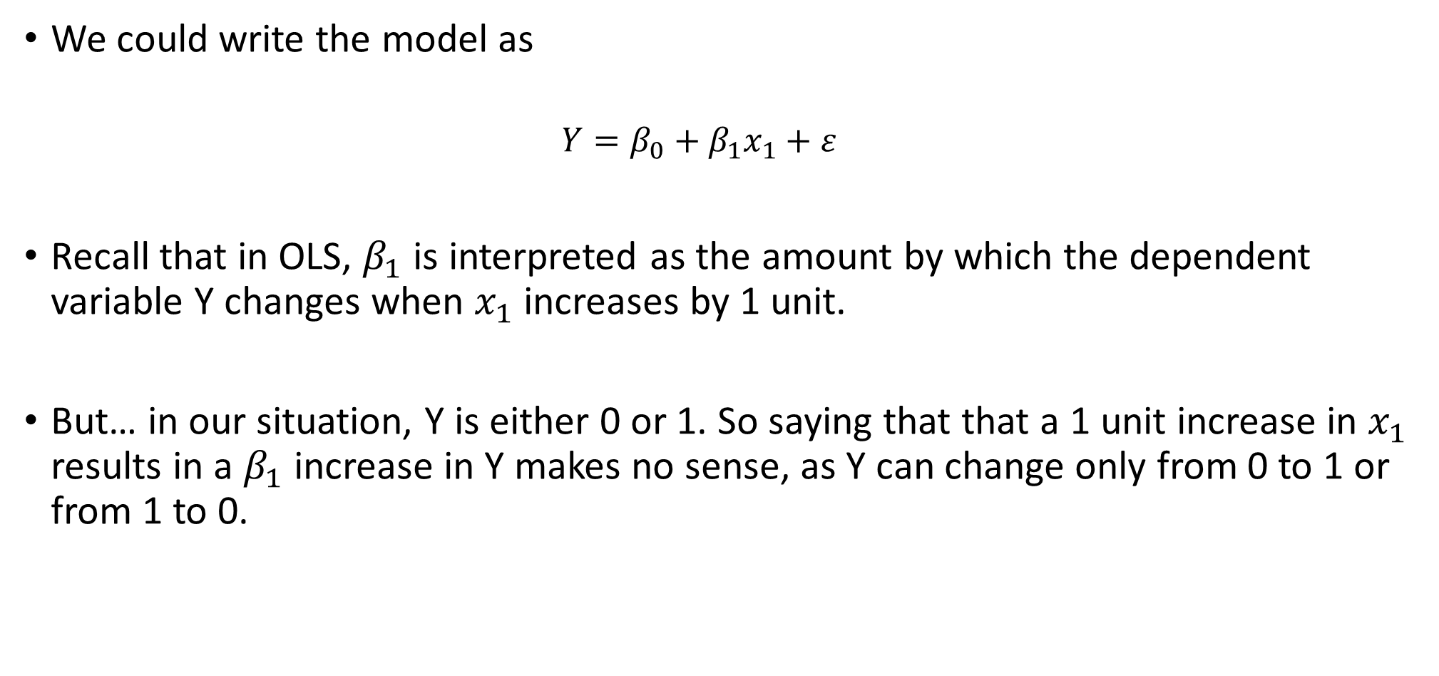
Issues with OLS when DV is binary
We could write the model as
$${Y=β}_{0}+β_{1}x_{1}+ε$$
Recall that in OLS, $β_{1}$ is interpreted as the amount by which the dependent variable Y changes when $x_{1}$ increases by 1 unit.
But… in our situation, Y is either 0 or 1. So saying that that a 1 unit increase in $x_{1}$ results in a $β_{1}$ increase in Y makes no sense, as Y can change only from 0 to 1 or from 1 to 0.

Slide 5
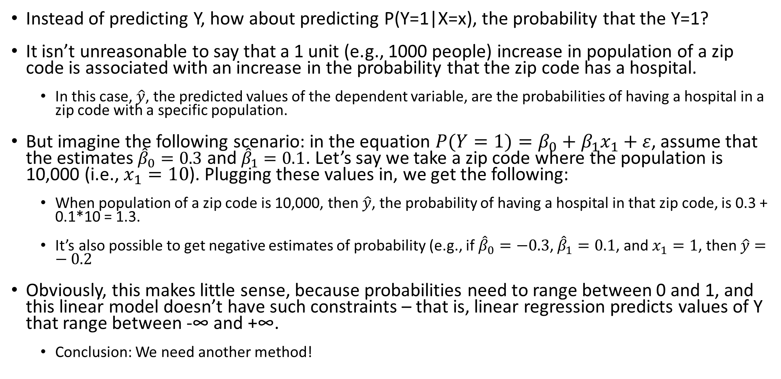
Potentially Getting Around the Issue
Instead of predicting Y, how about predicting P(Y=1|X=x), the probability that the Y=1?
It isn’t unreasonable to say that a 1 unit (e.g., 1000 people) increase in population of a zip code is associated with an increase in the probability that the zip code has a hospital.
In this case, $\hat{y}$, the predicted values of the dependent variable, are the probabilities of having a hospital in a zip code with a specific population.
But imagine the following scenario: in the equation ${P(Y=1)=β}_{0}+β_{1}x_{1}+ε$, assume that the estimates ${\hat{β}}_{0}=0.3$ and ${\hat{β}}_{1}=0.1$. Let’s say we take a zip code where the population is 10,000 (i.e., $x_{1}=10$). Plugging these values in, we get the following:
When population of a zip code is 10,000, then $\hat{y}$, the probability of having a hospital in that zip code, is 0.3 + 0.1*10 = 1.3.
It’s also possible to get negative estimates of probability (e.g., if ${\hat{β}}_{0}=−0.3$, ${\hat{β}}_{1}=0.1$, and $x_{1}=1$, then $\hat{y}=−0.2$
Obviously, this makes little sense, because probabilities need to range between 0 and 1, and this linear model doesn’t have such constraints – that is, linear regression predicts values of Y that range between -∞ and +∞.
Conclusion: We need another method!

Slide 6
But What Can We Get From the Earlier Results?
Intuitively, if the linear probability model predicts a 1.30 = 130% chance of having a hospital in a zip code, we expect that there would be a very large probability of there being a hospital there.
Likewise, if we predict a -0.2 = -20% chance of having a hospital in a zip code, we expect that there would be a very small probability of there being a hospital there.
We need a procedure to translate our linear regression results into true probabilities.
We need a function that takes a value from -∞ to +∞ and returns a value from 0 to 1.
Source: wps.aw.com/wps/media/objects/2387/2445250/PPTs/ch19lectr28.ppt

Slide 7

We Want a Translator Function Such That
The closer the $\hat{y}$ value from our linear regression model is to -∞, the closer our predicted probability is to 0.
The closer the $\hat{y}$ value from our linear regression model is to +∞, the closer our predicted probability is to 1.
No predicted probabilities are less than 0 or greater than 1.

Slide 8
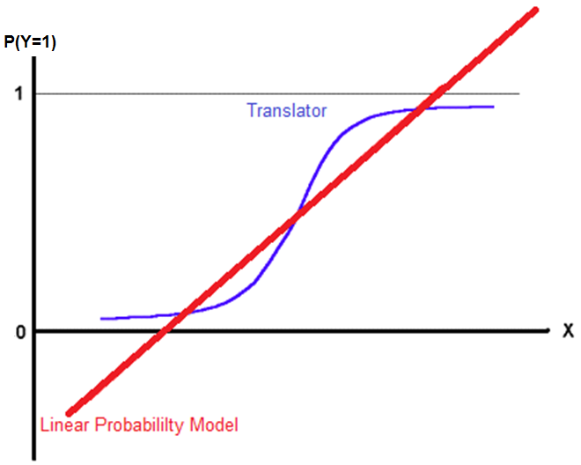
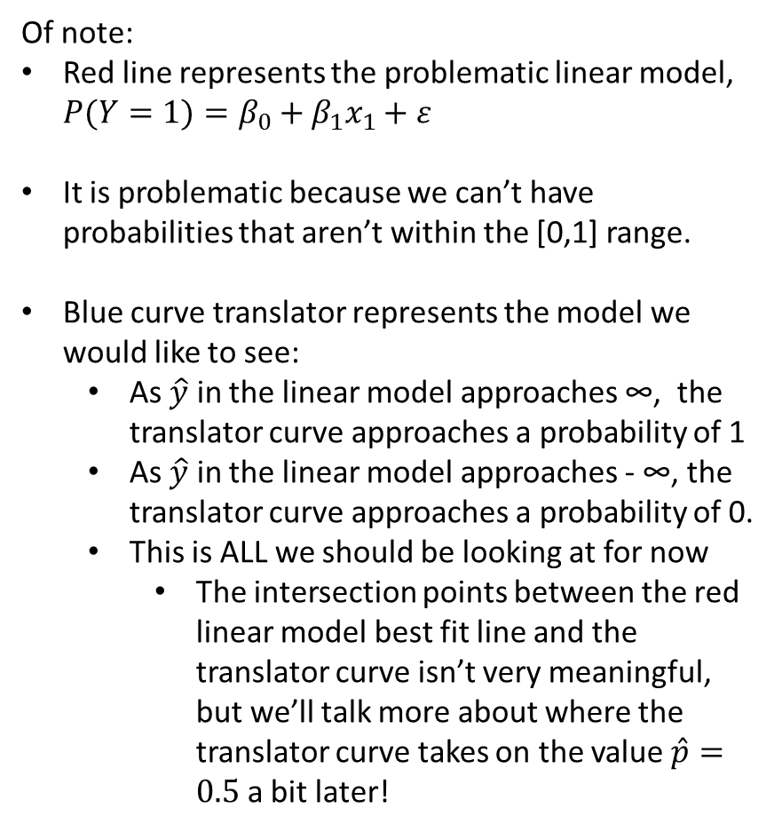
This Translator Function Might Look Like This
Of note:
Red line represents the problematic linear model, ${P(Y=1)=β}_{0}+β_{1}x_{1}+ε$
It is problematic because we can’t have probabilities that aren’t within the [0,1] range.
Blue curve translator represents the model we would like to see:
As $\hat{y}$ in the linear model approaches ∞, the translator curve approaches a probability of 1
As $\hat{y}$ in the linear model approaches - ∞, the translator curve approaches a probability of 0.
This is ALL we should be looking at for now
The intersection points between the red linear model best fit line and the translator curve isn’t very meaningful, but we’ll talk more about where the translator curve takes on the value $\hat{p}=0.5$ a bit later!

Slide 9
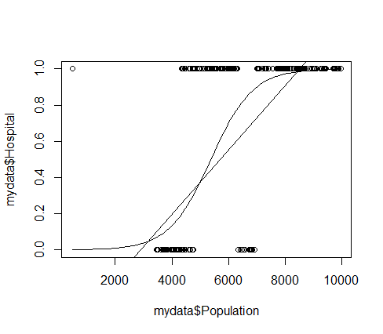
Example with Data

Slide 10
Examples of Translator Functions
Statisticians generally use 2 translator functions of this sort:
Probit
Logit (or more specifically, Logistic)
The differences between the two models are subtle.
We will focus on the logit translator for this course.
Source: wps.aw.com/wps/media/objects/2387/2445250/PPTs/ch19lectr28.ppt

Slide 11
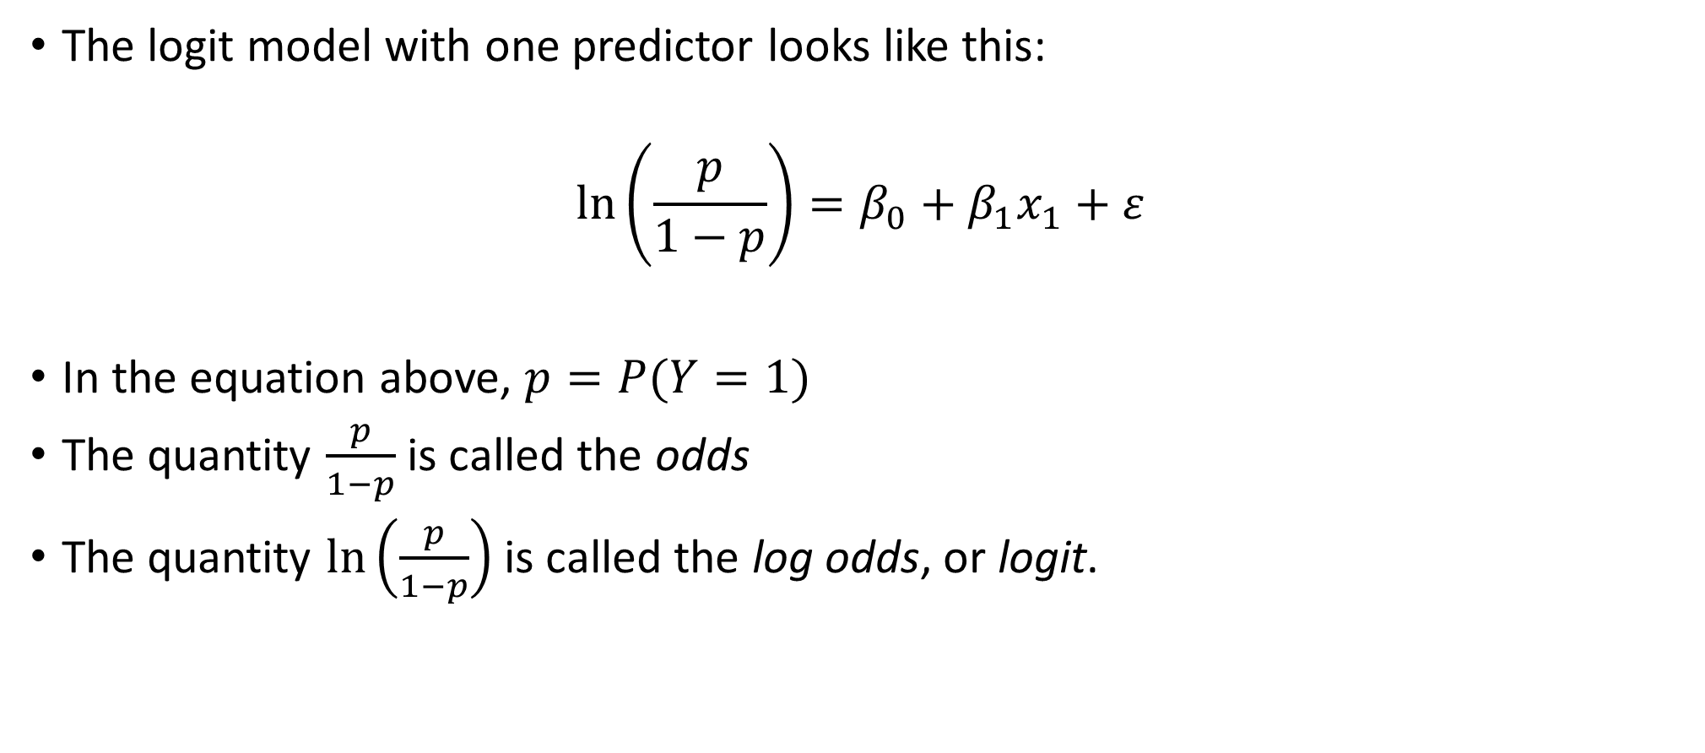
The Logit Function
The logit model with one predictor looks like this:
$$\ln\left(\frac{p}{1−p}\right)=β_{0}+β_{1}x_{1}+ε$$
In the equation above, $p=P(Y=1)$
The quantity $\frac{p}{1−p}$ is called the odds
The quantity $\ln\left(\frac{p}{1−p}\right)$ is called the log odds, or logit.

Slide 12
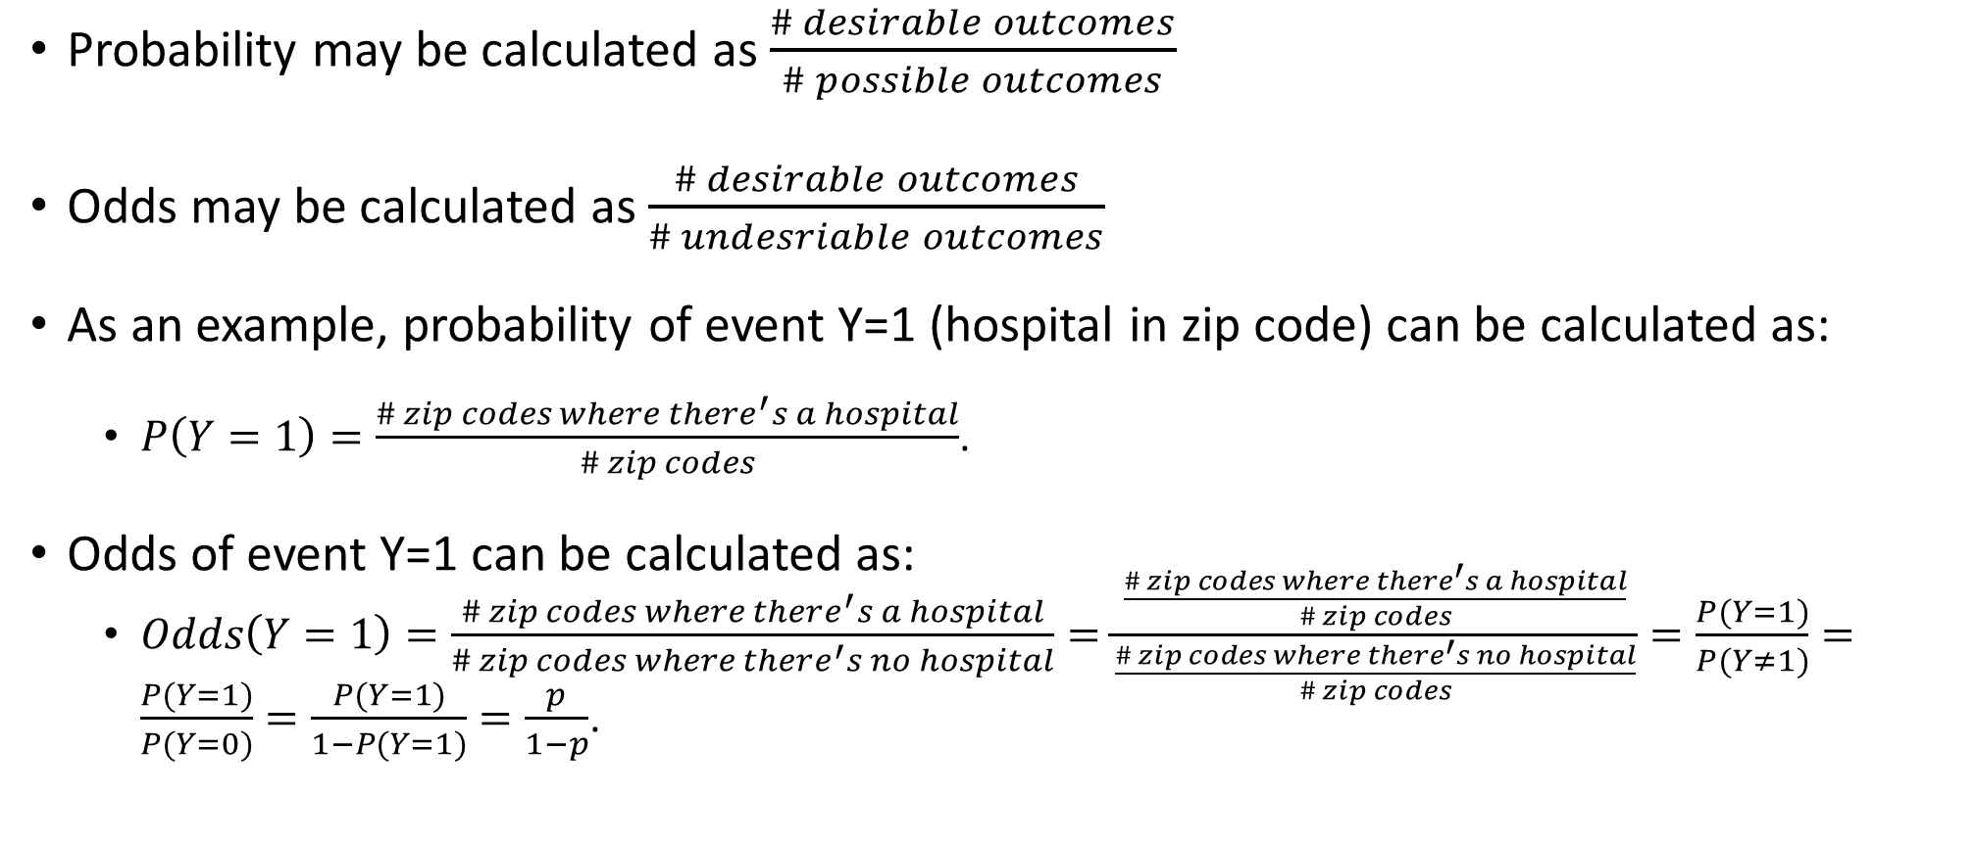
A Bit More About Odds
Probability may be calculated as $\frac{\# desirable outcomes}{\# possible outcomes}$
Odds may be calculated as $\frac{\# desirable outcomes}{\# undesriable outcomes}$
As an example, probability of event Y=1 (hospital in zip code) can be calculated as:
$P\left(Y=1\right)=\frac{\# zip codes where there^{′}s a hospital}{\# zip codes}$.
Odds of event Y=1 can be calculated as:
$Odds\left(Y=1\right)=\frac{\# zip codes where there^{′}s a hospital}{\# zip codes where there^{′}s no hospital}=\frac{\frac{\# zip codes where there^{′}s a hospital}{\# zip codes}}{\frac{\# zip codes where there^{′}s no hospital}{\# zip codes}}=\frac{P(Y=1)}{P(Y≠1)}=\frac{P(Y=1)}{P(Y=0)}=\frac{P(Y=1)}{1−P(Y=1)}=\frac{p}{1−p}$.

Slide 13
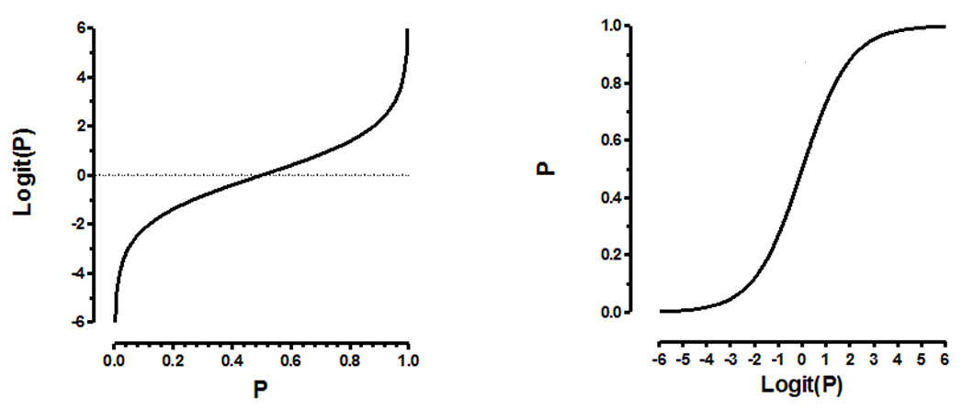

What Happens If We Take the Log of the Odds?
$$Logit=ln\left(\frac{p}{1−p}\right)$$
Source: http://www.graphpad.com/support/faqid/1465/

Slide 14
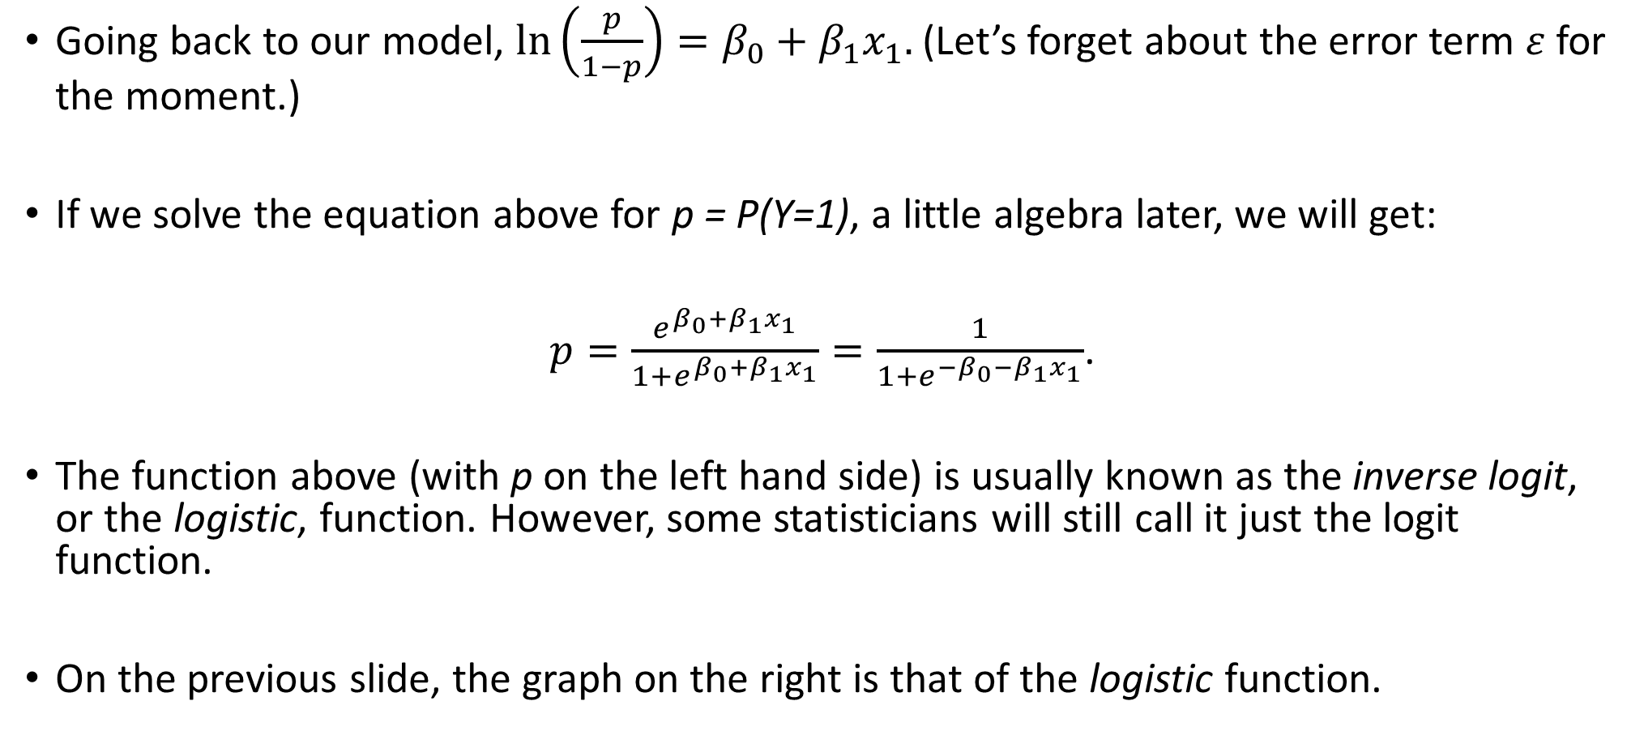
The Logistic Function (AKA Inverse-Logit Function)
Going back to our model, $\ln\left(\frac{p}{1−p}\right)=β_{0}+β_{1}x_{1}.$ (Let’s forget about the error term $ε$ for the moment.)
If we solve the equation above for p = P(Y=1), a little algebra later, we will get:
$p=\frac{e^{β_{0}+β_{1}x_{1}}}{1+e^{β_{0}+β_{1}x_{1}}}=\frac{1}{1+e^{{−β}_{0}−β_{1}x_{1}}}$.
The function above (with p on the left hand side) is usually known as the inverse logit, or the logistic, function. However, some statisticians will still call it just the logit function.
On the previous slide, the graph on the right is that of the logistic function.

Slide 15
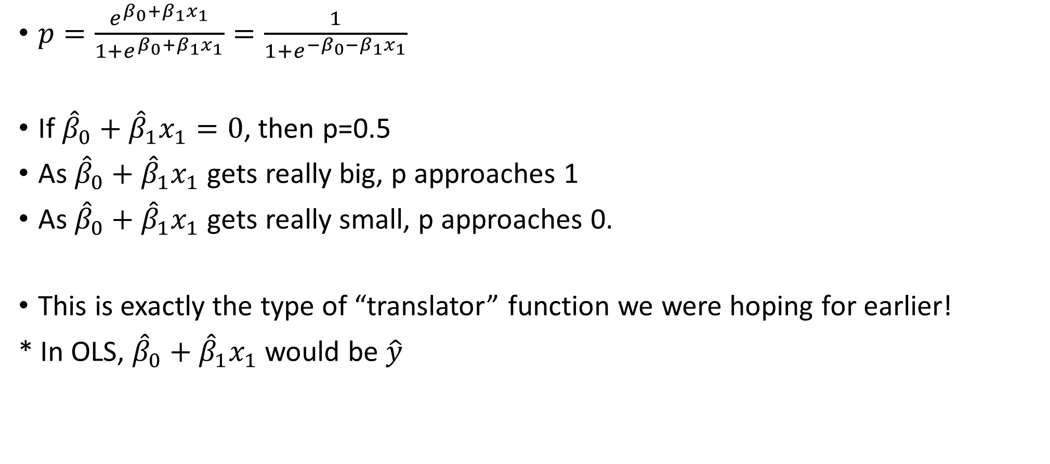
Properties of the Logistic Function
$p=\frac{e^{β_{0}+β_{1}x_{1}}}{1+e^{β_{0}+β_{1}x_{1}}}=\frac{1}{1+e^{{−β}_{0}−β_{1}x_{1}}}$
If ${\hat{β}}_{0}+{\hat{β}}_{1}x_{1}=0$, then p=0.5
As ${\hat{β}}_{0}+{\hat{β}}_{1}x_{1}$ gets really big, p approaches 1
As ${\hat{β}}_{0}+{\hat{β}}_{1}x_{1}$ gets really small, p approaches 0.
This is exactly the type of “translator” function we were hoping for earlier!
* In OLS, ${\hat{β}}_{0}+{\hat{β}}_{1}x_{1}$ would be $\hat{y}$

Slide 16
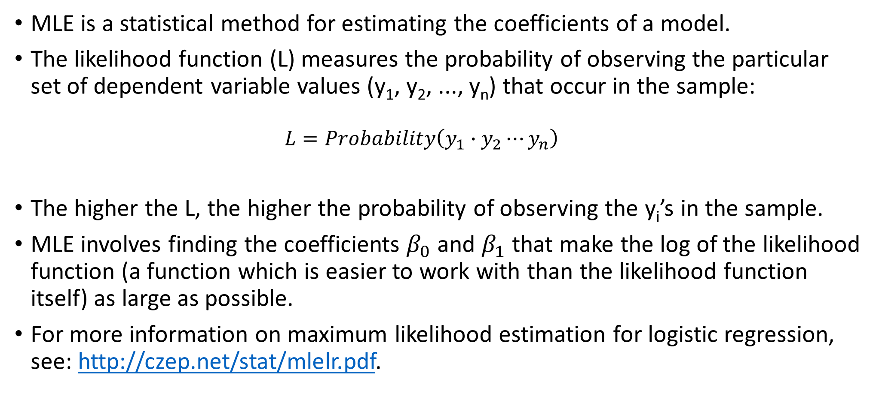
Maximum Likelihood Estimation (MLE) of Parameters
MLE is a statistical method for estimating the coefficients of a model.
The likelihood function (L) measures the probability of observing the particular set of dependent variable values (y₁, y₂, ..., y_{n}) that occur in the sample:
$$L=Probability\left(y_{1}∙y_{2}⋯y_{n}\right)$$
The higher the L, the higher the probability of observing the y_{i}’s in the sample.
MLE involves finding the coefficients $β_{0}$ and $β_{1}$ that make the log of the likelihood function (a function which is easier to work with than the likelihood function itself) as large as possible.
For more information on maximum likelihood estimation for logistic regression, see: http://czep.net/stat/mlelr.pdf.
Source: www.appstate.edu/~whiteheadjc/service/logit/

Slide 17
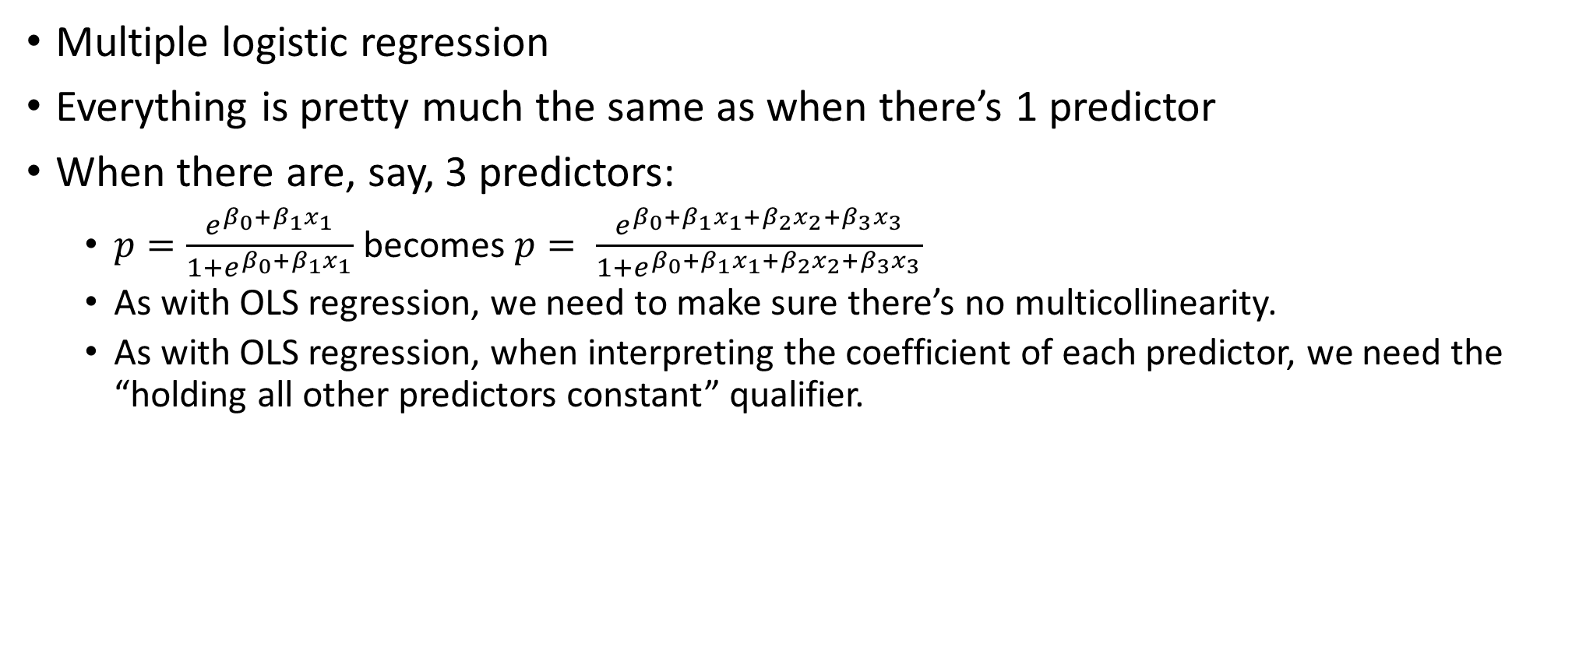
What Happens When We Have 2+ Predictors?
Multiple logistic regression
Everything is pretty much the same as when there’s 1 predictor
When there are, say, 3 predictors:
$p=\frac{e^{β_{0}+β_{1}x_{1}}}{1+e^{β_{0}+β_{1}x_{1}}}$ becomes $p= \frac{e^{β_{0}+β_{1}x_{1}+β_{2}x_{2}+β_{3}x_{3}}}{1+e^{β_{0}+β_{1}x_{1}+β_{2}x_{2}+β_{3}x_{3}}}$
As with OLS regression, we need to make sure there’s no multicollinearity.
As with OLS regression, when interpreting the coefficient of each predictor, we need the “holding all other predictors constant” qualifier.

Slide 18
Assumptions of Logistic Regression
Recall the assumptions of OLS:
Independence of observations
Linear relationship between DV and each predictor
Normality of residuals
Homoscedasticity
No multicollinearity
Assumptions of Logistic Regression
DV must be binary
Independence of observations
No severe multicollinearity
Larger samples are needed than for linear regression because MLE (and not least squares) is used to estimate regression coefficients.
You need at least 50 observations per predictor (compared to about 10 per predictor in OLS regression)
But in Logistic Regression
There’s no assumption that there needs to be a linear relationship between DV and each IV
No assumption of homoscedasticity
Residuals don’t need to be normal

Slide 19
Let’s Run Some Regressions!
The following slides will be structured like this:
First we’ll talk about getting the required packages and libraries in R, and importing the data into R
Then, we’ll go over how to interpret the logistic regression coefficients
In practice, this should really be done only for those variables which are statistically significant
Then, we’ll talk about the significance tests for each coefficient
Then we’ll talk about goodness of fit measures

Slide 20
R Code
#Logistic Regression in R: #http://www.ats.ucla.edu/stat/r/dae/logit.htm
install.packages("aod")
install.packages("ggplot2")
install.packages("rms")
install.packages("gmodels")
library(aod)
library(ggplot2)
library(rms)
library(gmodels)
setwd("C:/Logistic Regression")
mydata <- read.csv("Logistic Regression Example.csv")
# View the first few rows of the data
head(mydata)
# Summarize each variable
summary(mydata)

Slide 21
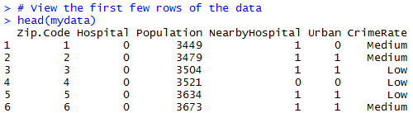
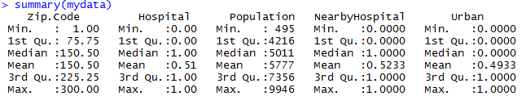
Output

Slide 22
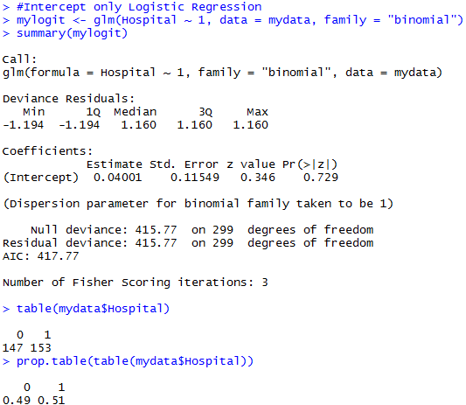
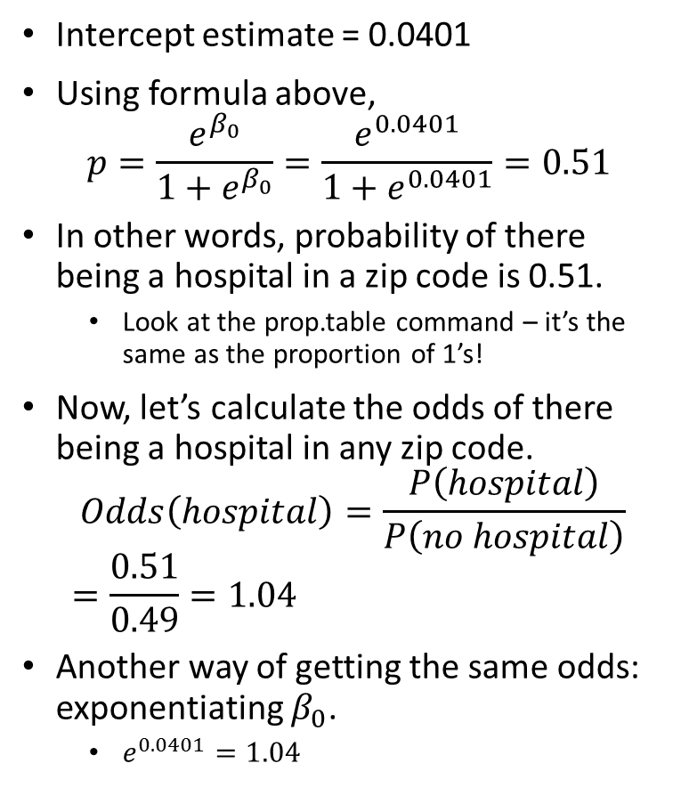
Let’s First Run an Intercept-Only Model in R: $p=\frac{e^{β_{0}}}{1+e^{β_{0}}}$
Intercept estimate = 0.0401
Using formula above,
$$p=\frac{e^{β_{0}}}{1+e^{β_{0}}}=\frac{e^{0.0401}}{1+e^{0.0401}}=0.51$$
In other words, probability of there being a hospital in a zip code is 0.51.
Look at the prop.table command – it’s the same as the proportion of 1’s!
Now, let’s calculate the odds of there being a hospital in any zip code.
$$Odds\left(hospital\right)=\frac{P\left(hospital\right)}{P\left(no hospital\right)}=\frac{0.51}{0.49}=1.04$$
Another way of getting the same odds: exponentiating $β_{0}$.
$e^{0.0401}=1.04$
Log odds of there being a hospital
Source: http://www.ats.ucla.edu/stat/mult_pkg/faq/general/odds_ratio.htm

Slide 23
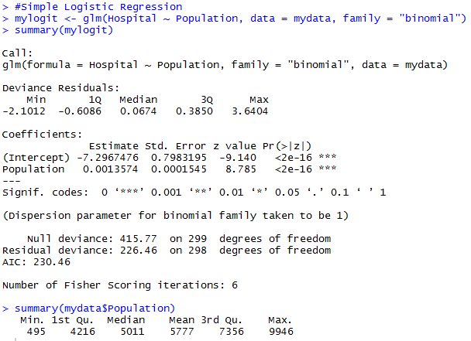
Let’s Run a Model with 1 Continuous Predictor: $p=\frac{e^{β_{0}+β_{1}x_{1}}}{1+e^{β_{0}+β_{1}x_{1}}}$
Intercept estimate = -7.297
In this case, the estimated coefficient for the intercept is the log odds of a zip code with population 0 having a hospital.
In other words, the odds of there being a hospital when population is 0 is exp(-7.297) = .00068.
These are really low odds, but if we look at the distribution of the variable Population, we will see that the minimum value is 495 and there are no zip codes with population 0. So here, 0 is a hypothetical value.
How do we interpret the coefficient estimate of 0.00135 for the Population variable?

Slide 24

Model with 1 Continuous Predictor (Cont’d)
The coefficient for population is 0.00136. If we plug it (and the value of the intercept) into the model equation, we will get:
$p=\frac{e^{β_{0}+β_{1}x_{1}}}{1+e^{β_{0}+β_{1}x_{1}}}=\frac{e^{−7.297+0.00136∗Population}}{{1+e}^{−7.297+0.00136∗Population}}.$
Written differently, this model equation is $\ln\left(\frac{p}{1−p}\right)=logit\left(p\right)=−7.297+0.00136∗Population$
Imagine we fix Population at (ANY) two consecutive values, say, 1000 and 1001.
$$\ln\left(\left.\frac{p}{1−p}\right|Population=1000\right)=−7.297+0.00136∗1000=−5.937$$
$$\ln\left(\left.\frac{p}{1−p}\right|Population=1001\right)=−7.297+0.00136∗1001=−5.93564$$
These are the respective log odds of there being a hospital in a zip code where the population is 1000 and 1001.
We can also examine the effect of a 1 unit (i.e., 1 person) increase in population on log odds of there being a hospital:
$$\ln\left(\left.\frac{p}{1−p}\right|Population=1001\right)−\ln\left(\left.\frac{p}{1−p}\right|Population=1000\right)=−5.93564−\left(−5.937\right)=0.00136$$
Notice that this is the value of the coefficient estimate of the variable Population! We can now say that for a one unit increase in Population, the value of the coefficient is the expected change in log odds of there being a hospital in the zip code. And it doesn’t matter if we’re talking about an increase in Population from 1000 to 1001 or from 3238 to 3239 – as long as it’s a one unit increase!

Slide 25
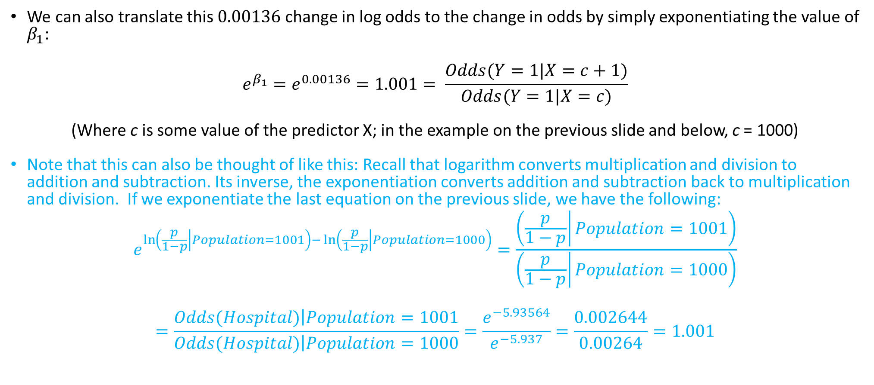
Model with 1 Continuous Predictor (Cont’d)
We can also translate this $0.00136$change in log odds to the change in odds by simply exponentiating the value of $β_{1}$:
$$e^{β_{1}}=e^{0.00136}=1.001= \frac{Odds(Y=1|X=c+1)}{Odds(Y=1|X=c)}$$
(Where c is some value of the predictor X; in the example on the previous slide and below, c = 1000)
Note that this can also be thought of like this: Recall that logarithm converts multiplication and division to addition and subtraction. Its inverse, the exponentiation converts addition and subtraction back to multiplication and division. If we exponentiate the last equation on the previous slide, we have the following:
$$e^{\ln\left(\left.\frac{p}{1−p}\right|Population=1001\right)−\ln\left(\left.\frac{p}{1−p}\right|Population=1000\right)}=\frac{\left(\left.\frac{p}{1−p}\right|Population=1001\right)}{\left(\left.\frac{p}{1−p}\right|Population=1000\right)}$$
$$=\frac{\left.Odds(Hospital)\right|Population=1001}{\left.Odds(Hospital)\right|Population=1000}=\frac{e^{−5.93564}}{e^{−5.937}}=\frac{0.002644}{0.00264}=1.001$$

Slide 26

Interpretation
We can say that $e^{β_{1}}$ is the extent to which the odds of Y=1 (i.e., the odds of there being a hospital in a zip code) change as the predictor (i.e., Population) increases by 1 unit. So, when $e^{β_{1}}=1.001$, 1.001 is the factor by which the odds of there being a hospital go up as population increases by 1 individual.
What if we want to examine the extent to which the odds of there being a hospital changes when population increases by 100 people? The calculation is pretty simple: $e^{{100∗β}_{1}}=e^{100∗0.00136}=1.15$. So, the odds of there being a hospital in a zip code increase by a factor of 1.15 when population increases by 100 people.

Slide 27

Interpretation
We can also say that a 1 unit increase in the predictor corresponds to a ${(e}^{β_{1}}−1)∗100\%$ change in the odds of Y=1. In the current example, we could say that when Population increases by 1 person, the odds of there being a hospital in the zip code goes up by $\left(1.001−1\right)∗100\%=0.1$%.
What if $β_{1}<0$ (i.e., there’s a negative association between the dependent variable and the predictor)? In our example above, if $β_{1}=−0.1$, we could say that the odds of there being a hospital in a zip code changes (i.e., decreases) by a factor of $e^{β_{1}}=e^{−0.1}=0.9$ as population increases by 1.
What happens when $β_{1}=0?$ Intuitively, it means that the predictor has no effect on the dependent variable. (Later we will see that this corresponds to an odds ratio of $e^{0}=1$.)

Slide 28
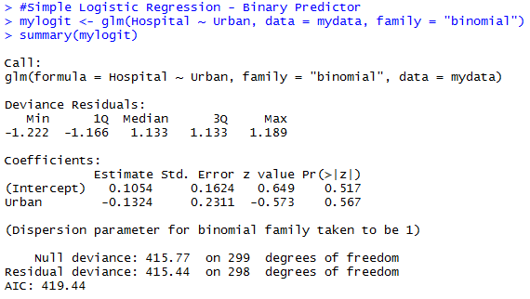
Let’s Run a Model with 1 Binary Predictor: $p=\frac{e^{β_{0}+β_{1}x_{1}}}{1+e^{β_{0}+β_{1}x_{1}}}$
The binary predictor is Urban, or whether the zip code is urban (1) or non-urban(0).
For the sake of this example, imagine that URBAN is a significant predictor.

Slide 29
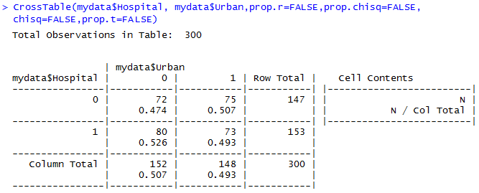
Model with 1 Binary Predictor (Cont’d)
For the sake of this example, imagine that URBAN is a significant predictor.
First, we can manually calculate the odds of there being a hospital in a non-urban zip code (x=0) as 80/72 and the odds of there being a hospital in an urban zip (x=1) code as 73/75.
The ratio of the odds of there being a hospital in urban zip codes to the odds of there being a hospital in non-urban zip codes is (73/75)/(80/72) = 0.876
And if you take the coefficient of Urban on the previous slide (-0.1324) and exponentiate it, you will get… 0.876.
Alternatively, the ratio of the odds of there being a hospital in non-urban zip codes to the odds of there being a hospital in urban zip codes is (80/72)/(73/75) = 1/0.876 = 1.142

Slide 30
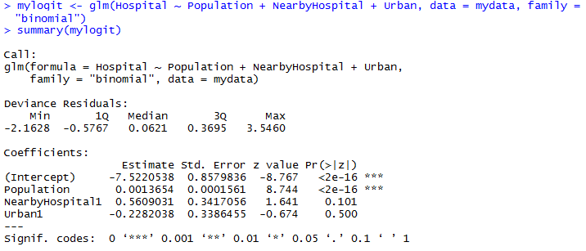
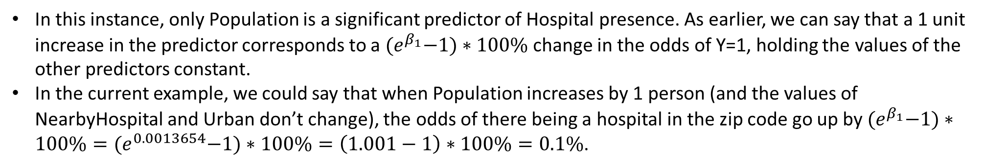
Model with Several Predictors
In this instance, only Population is a significant predictor of Hospital presence. As earlier, we can say that a 1 unit increase in the predictor corresponds to a ${(e}^{β_{1}}−1)∗100\%$ change in the odds of Y=1, holding the values of the other predictors constant.
In the current example, we could say that when Population increases by 1 person (and the values of NearbyHospital and Urban don’t change), the odds of there being a hospital in the zip code go up by ${(e}^{β_{1}}−1)∗100\%={(e}^{0.0013654}−1)∗100\%=\left(1.001−1\right)∗100\%=0.1\%$.

Slide 31
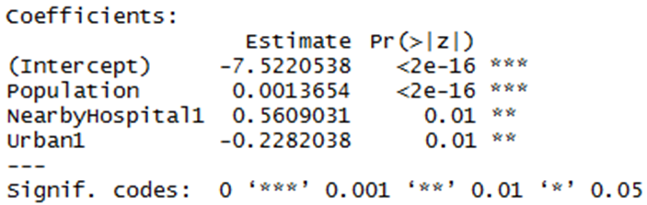
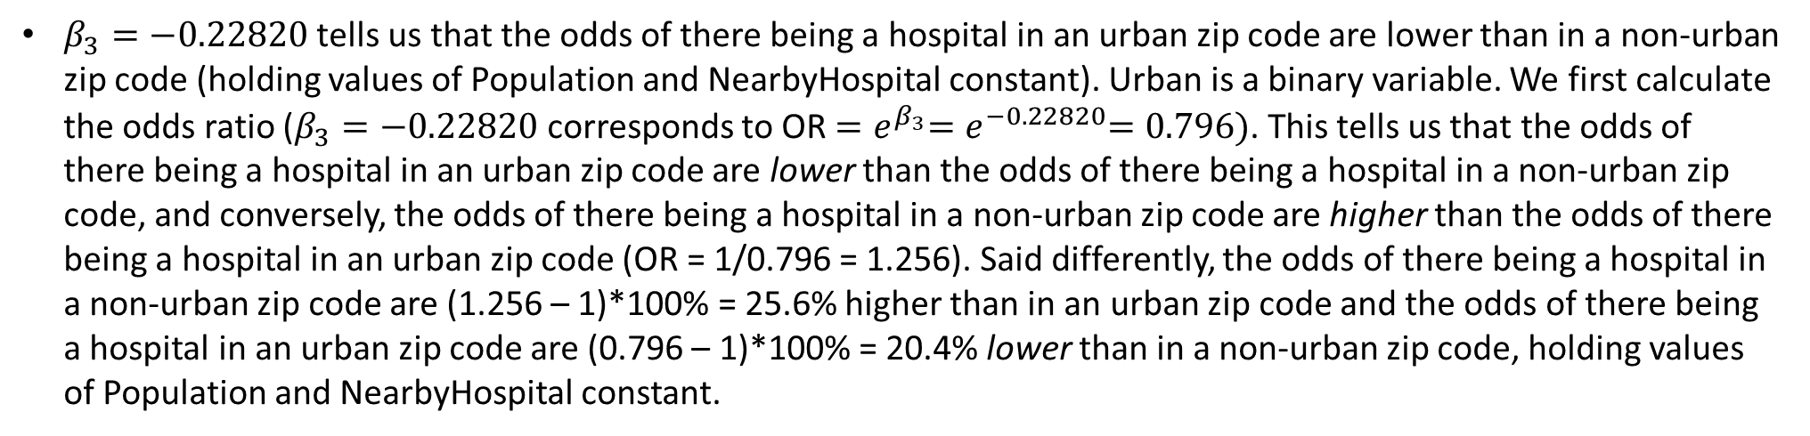

Imagine All Predictors Are Significant!
When Population goes up by 1 person (and values of NearbyHospital and Urban don’t change) the odds of there being a hospital in the zip code go up by ${(e}^{β_{1}}−1)∗100\%={(e}^{0.00136}−1)∗100\%=$ $0.1$%.
The odds of there being a hospital in a zip code go up by ${(e}^{β_{2}}−1)∗100\%=$ ${(e}^{0.56090}−1)∗100\%=75.2\%$ if there’s a hospital in a nearby zip code, (holding values of Population and Urban constant).
$β_{3}=−0.22820$ tells us that the odds of there being a hospital in an urban zip code are lower than in a non-urban zip code (holding values of Population and NearbyHospital constant). Urban is a binary variable. We first calculate the odds ratio ($β_{3}=−0.22820$ corresponds to OR ${=e}^{β_{3}}{=e}^{−0.22820}=0.796)$. This tells us that the odds of there being a hospital in an urban zip code are lower than the odds of there being a hospital in a non-urban zip code, and conversely, the odds of there being a hospital in a non-urban zip code are higher than the odds of there being a hospital in an urban zip code (OR = 1/0.796 = 1.256). Said differently, the odds of there being a hospital in a non-urban zip code are (1.256 – 1)*100% = 25.6% higher than in an urban zip code and the odds of there being a hospital in an urban zip code are (0.796 – 1)*100% = 20.4% lower than in a non-urban zip code, holding values of Population and NearbyHospital constant.

Slide 32
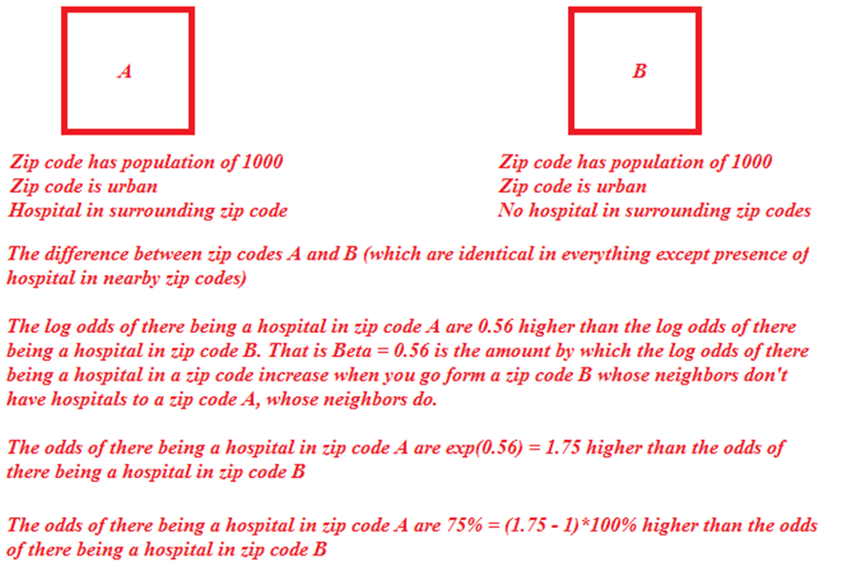
Elaborating…
NearbyHospital1 = 1 NearbyHospital1 = 0

Slide 33
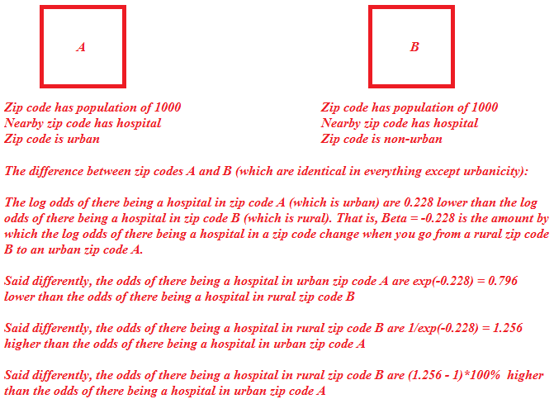
Elaborating…
Urban = 1 Urban = 0

Slide 34
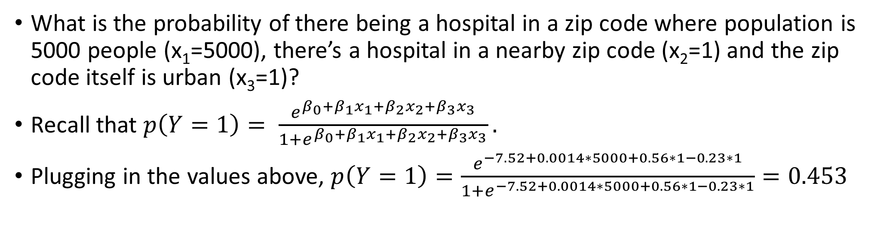
Example
What is the probability of there being a hospital in a zip code where population is 5000 people (x₁=5000), there’s a hospital in a nearby zip code (x₂=1) and the zip code itself is urban (x₃=1)?
Recall that $p\left(Y=1\right)= \frac{e^{β_{0}+β_{1}x_{1}+β_{2}x_{2}+β_{3}x_{3}}}{1+e^{β_{0}+β_{1}x_{1}+β_{2}x_{2}+β_{3}x_{3}}}.$
Plugging in the values above, $p\left(Y=1\right)=\frac{e^{−7.52+0.0014∗5000+0.56∗1−0.23∗1}}{1+e^{−7.52+0.0014∗5000+0.56∗1−0.23∗1}}=0.453$

Slide 35
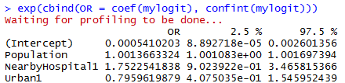
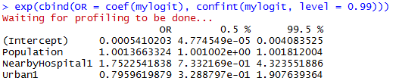
Calculating Odds Ratios from $β$Coefficients in R
The following R command gives the odds ratios (as well as the 95% confidence interval for the odds ratios)
If we want a 99% confidence interval for the odds ratio, we simply indicate it in the command:
What happens if 1 is in the CI?

Slide 36
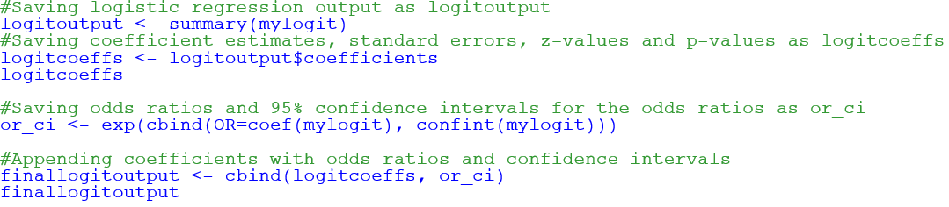
Merging Odds Ratios to $β$Coefficients in R
A good way to view the Coefficients, P-Values, Odds Ratios and Confidence Intervals together:

Slide 37
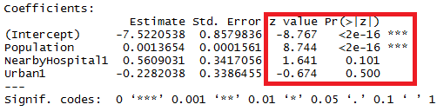
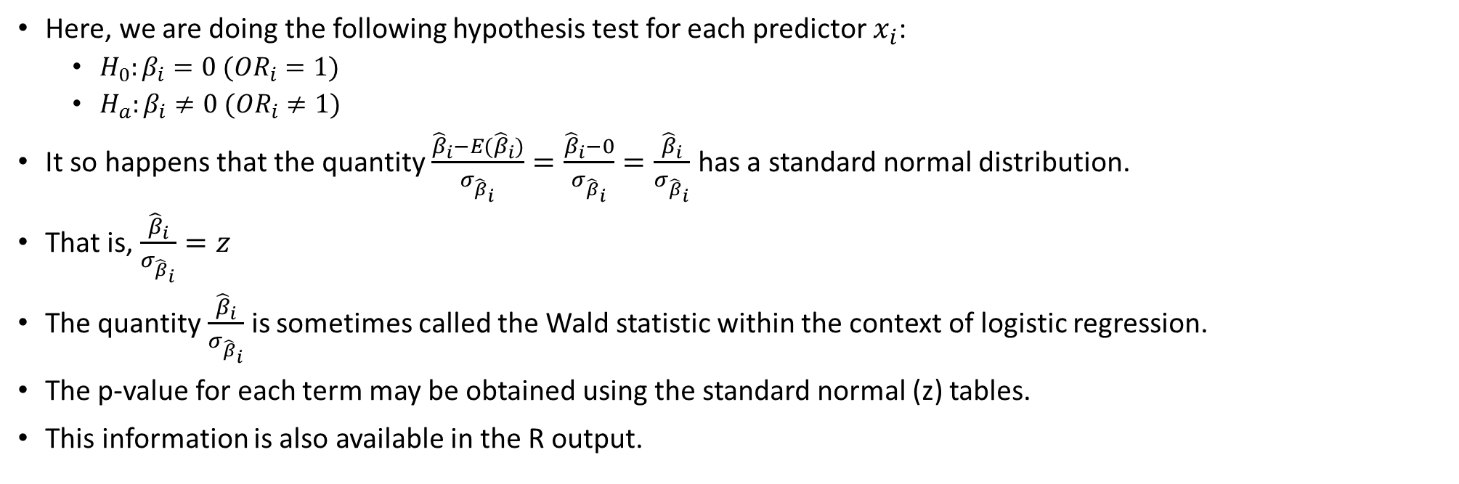
Hypothesis Tests
Here, we are doing the following hypothesis test for each predictor $x_{i}$:
$H_{0}:β_{i}=0 ({OR}_{i}=1)$
$H_{a}:β_{i}≠0 ({OR}_{i}≠1)$
It so happens that the quantity $\frac{{\hat{β}}_{i}−E({\hat{β}}_{i})}{σ_{{\hat{β}}_{i}}}=\frac{{\hat{β}}_{i}−0}{σ_{{\hat{β}}_{i}}}=\frac{{\hat{β}}_{i}}{σ_{{\hat{β}}_{i}}}$ has a standard normal distribution.
That is, $\frac{{\hat{β}}_{i}}{σ_{{\hat{β}}_{i}}}=z$
The quantity $\frac{{\hat{β}}_{i}}{σ_{{\hat{β}}_{i}}}$ is sometimes called the Wald statistic within the context of logistic regression.
The p-value for each term may be obtained using the standard normal (z) tables.
This information is also available in the R output.

Slide 38
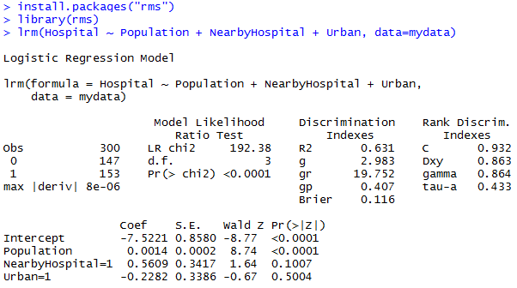
R-Squared
Formulas omitted here
The higher the R-Squared, the better
Unlike OLS regression, R-Squared cannot be interpreted as the % of variance explained by the model
It’s rarely used
The glm command in R doesn’t produce an R-Squared
We can use the rms package in R to run the Logistic regression. This yields an R-squared (Nagelkerke 1991*)
*Nagelkerke, N.J.D. (1991) “A note on a general definition of the coefficient of determination.” Biometrika 78: 691-692.

Slide 39
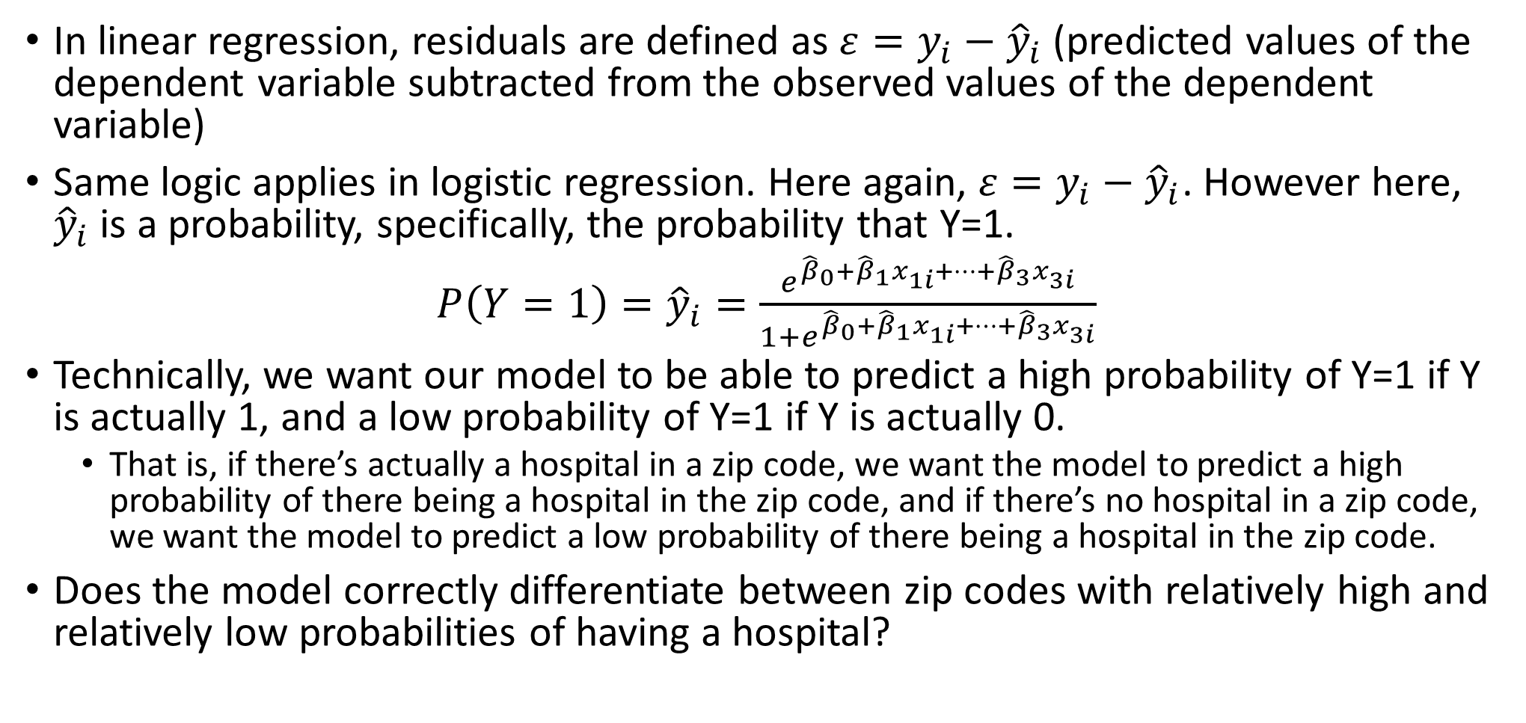
Goodness of Model Fit Statistics
In linear regression, residuals are defined as $ε=y_{i}−{\hat{y}}_{i}$ (predicted values of the dependent variable subtracted from the observed values of the dependent variable)
Same logic applies in logistic regression. Here again, $ε=y_{i}−{\hat{y}}_{i}$. However here, ${\hat{y}}_{i}$ is a probability, specifically, the probability that Y=1.
${P\left(Y=1\right)=\hat{y}}_{i}=\frac{e^{{\hat{β}}_{0}+{\hat{β}}_{1}x_{1i}+…+{\hat{β}}_{3}x_{3i}}}{1+e^{{\hat{β}}_{0}+{\hat{β}}_{1}x_{1i}+…+{\hat{β}}_{3}x_{3i}}}$
Technically, we want our model to be able to predict a high probability of Y=1 if Y is actually 1, and a low probability of Y=1 if Y is actually 0.
That is, if there’s actually a hospital in a zip code, we want the model to predict a high probability of there being a hospital in the zip code, and if there’s no hospital in a zip code, we want the model to predict a low probability of there being a hospital in the zip code.
Does the model correctly differentiate between zip codes with relatively high and relatively low probabilities of having a hospital?

Slide 40
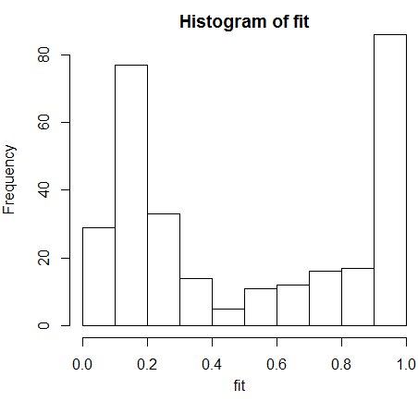


What Are Relatively High and Relatively Low Probabilities?
Let’s look at a histogram of fitted values ${(\hat{y}}_{i})$ in our example
The fitted values ${\hat{y}}_{i}$ (probabilities of there being a hospital in a zip code) in the histogram range between 0 and 1.
Let’s say that when ${\hat{y}}_{i}≥0.5$, we consider this to be a relatively high probability of there being a hospital in a zip code, and when ${\hat{y}}_{i}<0.5$, we consider this to be a relatively low probability of there being a hospital in a zip code.
That is, if the model is performing well, we would expect most of the zip codes where Y=1 to have higher ${\hat{y}}_{i}$ values (${\hat{y}}_{i}≥0.5$) and most of the zip codes where Y=0 to have lower ${\hat{y}}_{i}$ values (${\hat{y}}_{i}<0.5$) .
However, this “cut-off” value of 0.5 is quite arbitrary!
Here, it might work because earlier we saw that 51% of the zip codes had a hospital in our data set.

Slide 41
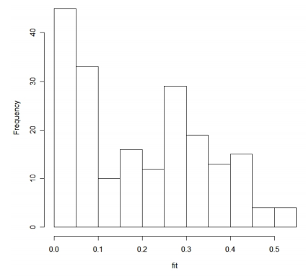
Another Example
If, say, only 20% of zip codes in our data had a hospital, the histogram might look like this
I.e., there wouldn’t be any zip codes where the predicted probability of a hospital goes above 0.6.
Here, a good cut-off probability value might be 0.3 instead of 0.5 – far too few zip codes would be predicted to have hospitals if we used the cut-off probability value of 0.5!
Source: http://www.medicine.mcgill.ca/epidemiology/joseph/courses/epib-621/logfit.pdf

Slide 42
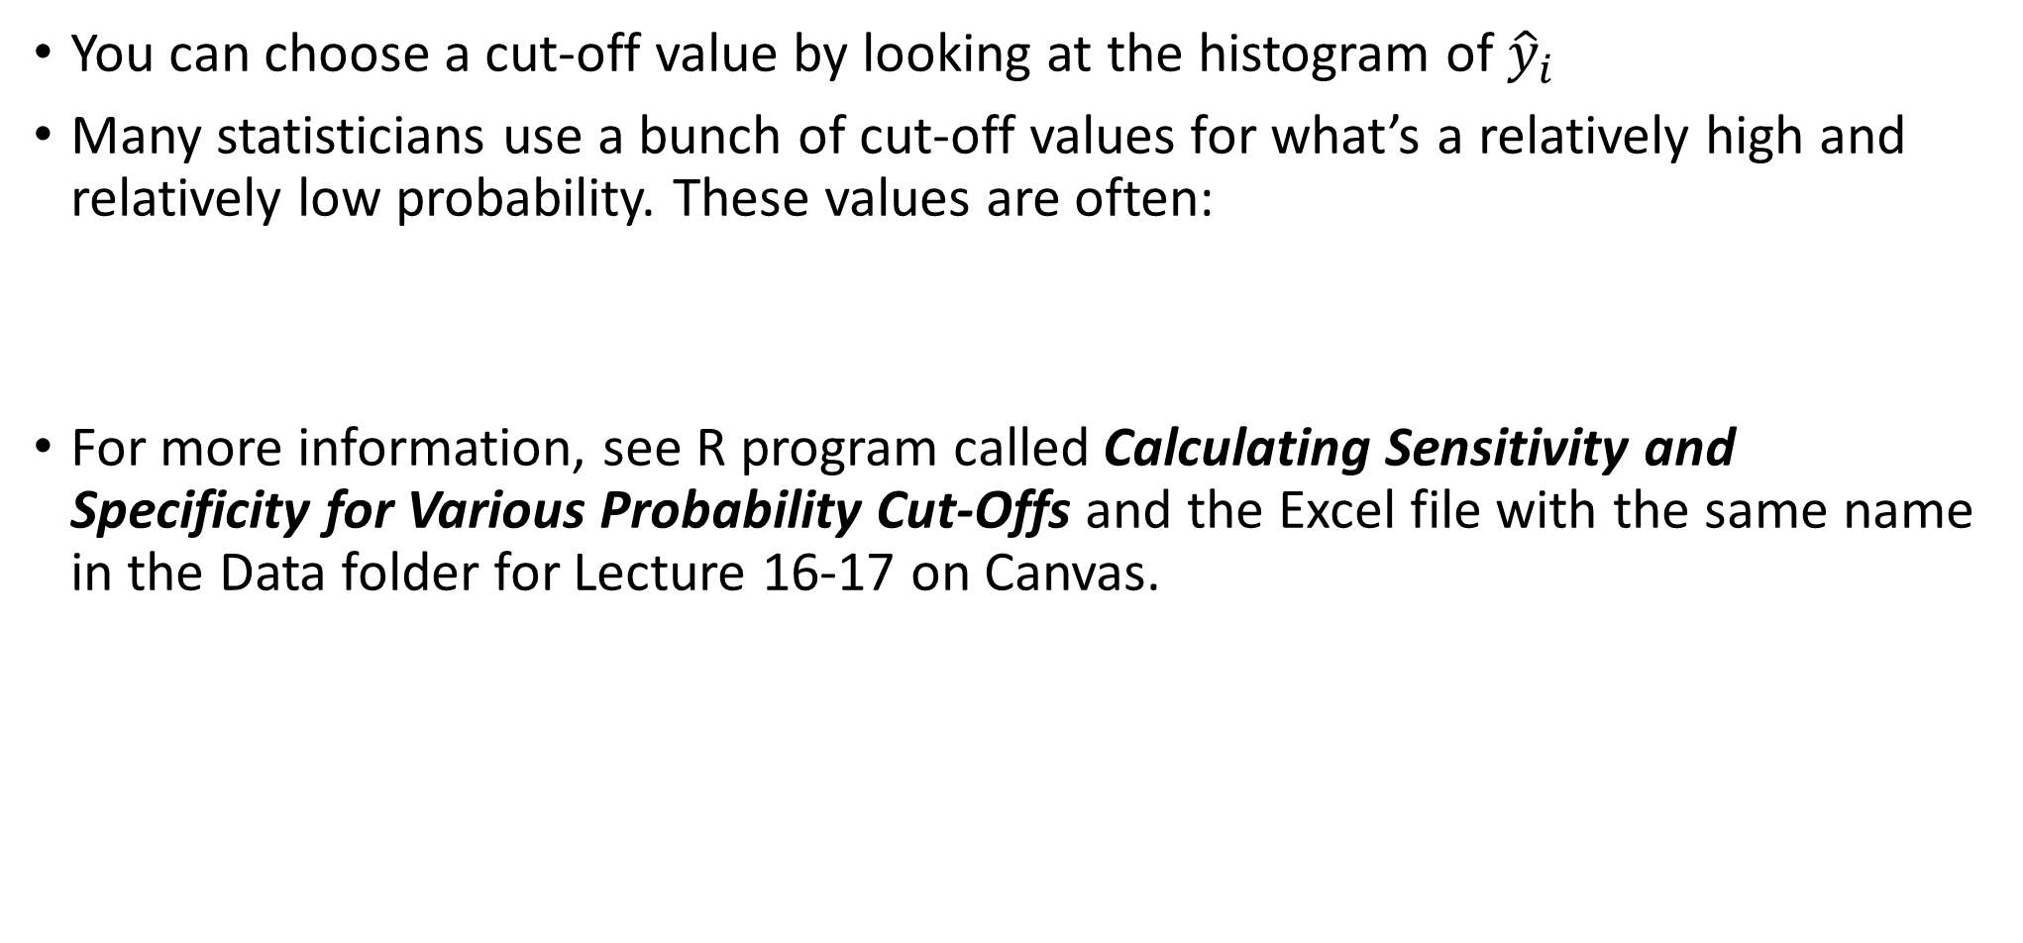
How Do I Choose a Cut-Off Value?
You can choose a cut-off value by looking at the histogram of ${\hat{y}}_{i}$
Many statisticians use a bunch of cut-off values for what’s a relatively high and relatively low probability. These values are often:
For more information, see R program called Calculating Sensitivity and Specificity for Various Probability Cut-Offs and the Excel file with the same name in the Data folder for Lecture 16-17 on Canvas.
0.1 | 0.2 | 0.3 | 0.4 | 0.5 | 0.6 | 0.7 | 0.8 | 0.9

Slide 43

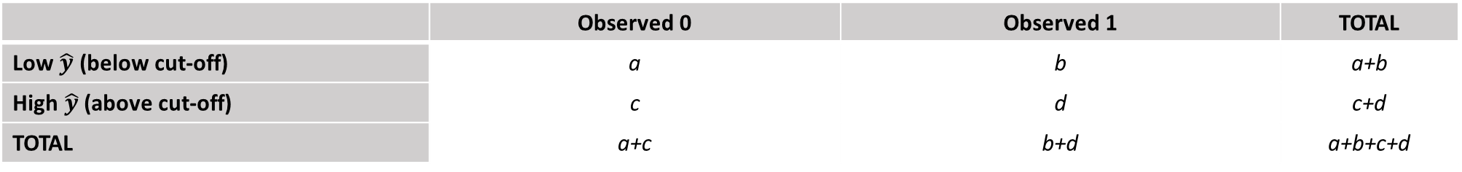



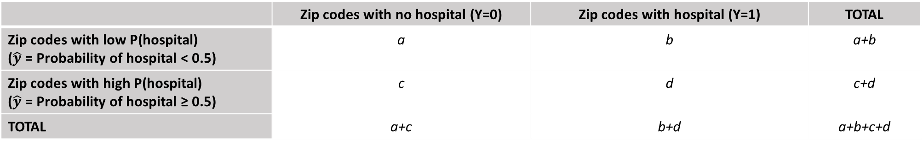

For Now, Let’s Stick to Cut-off Value of 0.5
Let’s create a table like the one below. In a good model, a and d will be high and b and c – low!
In our problem, we can have more clear labels:
In general, let’s define the following concepts:
 | Observed 0 | Observed 1 | TOTAL
Low $\hat{y}$ (below cut-off) | a | b | a+b
High $\hat{y}$(above cut-off) | c | d | c+d
TOTAL | a+c | b+d | a+b+c+d
 | Zip codes with no hospital (Y=0) | Zip codes with hospital (Y=1) | TOTAL
Zip codes with low P(hospital) ($\hat{y}$ = Probability of hospital < 0.5) | a | b | a+b
Zip codes with high P(hospital) ($\hat{y}$ = Probability of hospital ≥ 0.5) | c | d | c+d
TOTAL | a+c | b+d | a+b+c+d
$$Sensitivity= \frac{d}{b+d}$$
$$Specificity= \frac{a}{a+c}$$
$$False negative rate= \frac{b}{b+d}$$
$$False positive rate= \frac{c}{a+c}$$
$$Misclassification Rate= \frac{b+c}{a+b+c+d}$$
Notes:
Sensitivity: Proportion of observed 1’s correctly predicted; Specificity: proportion of observed 0’s that are correctly predicted

Slide 44
Some Formal Definitions
Sensitivity (also called the true positive rate) measures the proportion of actual positives which are correctly identified as such (e.g., the percentage of sick people who are correctly identified as having the condition), and is complementary to the false negative rate.
Specificity (also called the true negative rate) measures the proportion of negatives which are correctly identified as such (e.g., the percentage of healthy people who are correctly identified as not having the condition), and is complementary to the false positive rate.
Taken verbatim from: http://en.wikipedia.org/wiki/Sensitivity_and_specificity

Slide 45
Table In R…
#Generating a dummy variable fit.binary that sets fit to 1 if it's 0.5 or greater
#and 0 otherwise.
fit.binary = (fit>=0.5)
#Cross-Tabulation
CrossTable(fit.binary, mydata$Hospital, prop.r=FALSE, prop.t=FALSE, prop.chisq=FALSE)

Slide 46
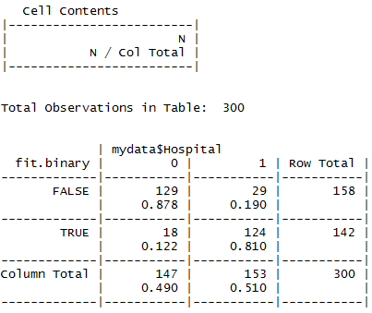



Results
Here:
a=129
b=29
c=18
d=124
So, when cut-off value is 0.5, we have:
$$Sensitivity= \frac{d}{b+d}=\frac{124}{29+124}=0.81$$
p < 0.5
$$Specificity= \frac{a}{a+c}=\frac{129}{129+18}=0.878$$
p >= 0.5
$$Misclassification Rate= \frac{b+c}{a+b+c+d}=0.157$$
We can do the same thing with other cut-off values – but we’ll skip it for the sake of time!

Slide 47
ROC Curves
A way to plot true positive rate (sensitivity) against false positive rate (i.e., 1 - specificity)
A best cut-off value may be determined by optimizing sensitivity and specificity
We can also use ROC curves to examine predictive quality of the model
A bit of history: ROC stands for "Receiver Operating Characteristic“. ROC analysis is part of a field called "Signal Detection Theory" developed during World War II for the analysis of radar images. Radar operators had to decide whether a blip on the screen represented an enemy target, a friendly ship, or just noise. Signal detection theory measures the ability of radar receiver operators to make these important distinctions. Their ability to do so was called the Receiver Operating Characteristics.
Source: http://gim.unmc.edu/dxtests/roc3.htm

Slide 48
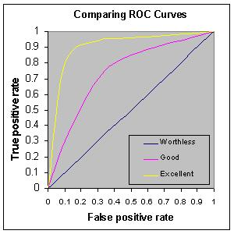
ROC Curves
Source: http://gim.unmc.edu/dxtests/roc3.htm
Note:
False Positive Rate = 1 - Specificity
ROC Curves will be to the left of this 45 degree line (i.e., the “worthless” ROC)
In this case, the sum of specificity and sensitivity can never be greater than 1!
Sensitivity
1 0.9 0.8 0.7 0.6 0.5 0.4 0.3 0.2 0.1 0
Specificity

Slide 49
Identifying probability cut-offs based on ROC Curves
A couple different ways for identifying the probability cut-offs based on ROC Curves exist:
Youden Index: A cut-off for which (Sensitivity + Specificity) is maximized
A cut-off for which the ROC curve has the minimum distance from the upper left corner of the graph – i.e., the point at which specificity = 1 and sensitivity = 1.
This is just a different way of maximizing specificity and sensitivity
We can implement this in R and get the optimal cut-off point and corresponding sensitivity and specificity

Slide 50
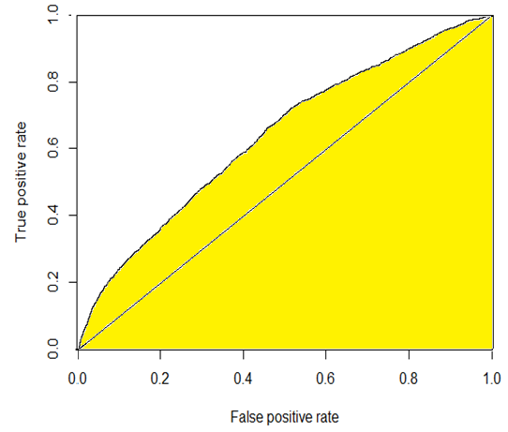
Area Under ROC Curves
Area under ROC Curve (AUC, which stands for Area Under Curve) is a measure of prediction accuracy of the model (how well a model predicts 1 responses as 1’s and 0 responses as 0’s).
Higher AUCs mean that we can find a cut-off value for which both sensitivity and specificity of the model are relatively high.
Possible values range between 0.5 (area under 45 degree line) and 1 (area of the entire box).
A rough guide for classifying the accuracy:
.90-1 = excellent
.80-.90 = good
.70-.80 = fair
.60-.70 = poor
.50-.60 = fail
These might be somewhat conservative estimates, and there will be statisticians who will say that area > .7 is just fine.
Source: http://gim.unmc.edu/dxtests/roc3.htm

Slide 51
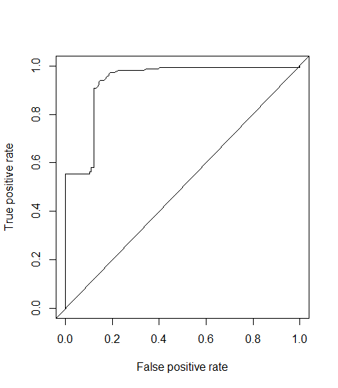
Let’s do this for our problem, in R…
#For more info, see: https://hopstat.wordpress.com/2014/12/19/a-small-introduction-to-the-rocr-package/
#a is a matrix combining the vectors containing y and y-hat in matrix a; first variable is hospital, which is y; second variable is fit, which is y-hat
a <- cbind(mydata$Hospital, fit)
#Here, predictions are estimated probabilities (i.e., p or y-hat values), and labels are actual y-values
#From above, we see that matrix a has 2 columns:
#The first one is mydata$Hospital, which are actual values of y (i.e., labels) and the second one is fit, which are predicted, or fitted values of y (i.e., predictions)
#Let's make the names of the variables easy to understand
colnames(a) <- c("labels", "predictions")
head(a)
roc <- as.data.frame(a)
pred <- prediction(roc$predictions, roc$labels)
#tpr = true positive rate, another term for sensitivity and fpr = false positive rate, or (1 – specificity)
roc.perf = performance(pred, measure = "tpr", x.measure="fpr")
plot(roc.perf)
#plotting 45 degree line for reference
abline(a=0,b=1)

Slide 52

In R (Cont’d)…
#Optimal cut-point, if you want to weigh specificity and sensitivity equally.
#The code below yields the cut-off value for which the ROC curve has the minimum distance from the upper left corner of the graph, where specificity = 1 and sensitivity = 1. (This is just a different way of maximizing both specificity and sensitivity).
#This is where the d = (x - 0)^2 + (y-1)^2 in the code below comes in.
opt.cut = function(perf, pred){
cut.ind = mapply(FUN=function(x, y, p){
d = (x - 0)^2 + (y-1)^2
ind = which(d == min(d))
c(sensitivity = y[[ind]], specificity = 1-x[[ind]],
cutoff = p[[ind]])
}, perf@x.values, perf@y.values, pred@cutoffs)
}
#This will print the optimal cut-off point and the corresponding specificity and sensitivity
print(opt.cut(roc.perf, pred))
#Seems that there exists a cut-off at which we can achieve pretty high sensitivity and specificity! This is indicative of a good predictive model.
#If you want to assign different weights (i.e., costs) to sensitivity and specificity, you may do so as well. Instructions here: https://hopstat.wordpress.com/2014/12/19/a-small-introduction-to-the-rocr-package/
#That is, a false negative (e.g., failure to diagnose a disease) may be more serious than a false positive.

Slide 53
In R (Cont’d)…
#Area under the ROC curve (AUC)
#Source: http://gim.unmc.edu/dxtests/roc3.htm
#The prediction accuracy of the model depends on how well
the model predicts 1 responses as 1's and 0 responses as 0's. Accuracy is measured by the area under the ROC curve. An
area of 1 represents a perfect test (prediction); an area of .5 represents a worthless test (prediction). A rough guide for interpreting area under ROC Curves:
.90-1 = excellent (A)
.80-.90 = good (B)
.70-.80 = fair (C)
.60-.70 = poor (D)
.50-.60 = fail (F)
These might be somewhat conservative estimates, and there will be statisticians who will say that area > .7 is just fine.
auc.perf = performance(pred, measure ="auc")
auc.perf@y.values
#Conclusion: based on the AUC, we have a fantastic predictive model!

Slide 54

Interpretation of the AUC
AUC may be interpreted as the probability that the model correctly ranks two randomly selected observations where one has $y=1$ and the other one has $y=0$.
In other words, imagine that you randomly select 2 observations:
Observation 1, for which $y=1$, and
Observation 2, for which $y=0$.
Recall that for each one of these observations, your logistic regression model estimates $\hat{y}=p=P\left(y=1\right)$
The AUC may be interpreted as the probability that the $\hat{y}$ for observation 1 (where $y=1$) will be higher than the $\hat{y}$ for observation 2 (where $y=0$).
An example: An AUC of .93397 means that, if you have 2 randomly selected zip codes, such that the first has a hospital and the second doesn’t, 93.397% of the time the $\hat{y}$ (i.e., the predicted probability of there being a hospital) in the first zip code will be higher than the $\hat{y}$ in the second zip code.
For more info, see: http://thestatsgeek.com/2014/05/05/area-under-the-roc-curve-assessing-discrimination-in-logistic-regression/ and video here: http://www.dataschool.io/roc-curves-and-auc-explained/

Slide 55
Cross-Validation
Similar to OLS, we can do cross-validation to determine a quality of the model.
See following links for more information:
K-Fold cross-validation in R: https://www.r-bloggers.com/evaluating-logistic-regression-models/
More on cross-validation in R: https://www.r-bloggers.com/predicting-creditability-using-logistic-regression-in-r-cross-validating-the-classifier-part-2-2/

Slide 56
Modeling Rare Events
Paul Allison, a leading expert on logistic regression, writes the following:
Prompted by a 2001 article by King and Zeng, many researchers worry about whether they can legitimately use conventional logistic regression for data in which events are rare. Although King and Zeng accurately described the problem and proposed an appropriate solution, there are still a lot of misconceptions about this issue.
The problem is not specifically the rarity of events, but rather the possibility of a small number of cases on the rarer of the two outcomes. If you have a sample size of 1000 but only 20 events, you have a problem. If you have a sample size of 10,000 with 200 events, you may be OK. If your sample has 100,000 cases with 2000 events, you’re golden.
There’s nothing wrong with the logistic model in such cases. The problem is that maximum likelihood estimation of the logistic model is well-known to suffer from small-sample bias. And the degree of bias is strongly dependent on the number of cases in the less frequent of the two categories. So even with a sample size of 100,000, if there are only 20 events in the sample, you may have substantial bias.
What’s the solution? King and Zeng proposed an alternative estimation method to reduce the bias. Their method is very similar to another method, known as penalized likelihood, that is more widely available in commercial software. Also called the Firth method, after its inventor, penalized likelihood is a general approach to reducing small-sample bias in maximum likelihood estimation. In the case of logistic regression, penalized likelihood also has the attraction of producing finite, consistent estimates of regression parameters when the maximum likelihood estimates do not even exist because of complete or quasi-complete separation.
Unlike exact logistic regression (another estimation method for small samples but one that can be very computationally intensive), penalized likelihood takes almost no additional computing time compared to conventional maximum likelihood. In fact, a case could be made for always using penalized likelihood rather than conventional maximum likelihood for logistic regression, regardless of the sample size.
Taken verbatim from: http://statisticalhorizons.com/logistic-regression-for-rare-events

Slide 57
Spatial regression models for binary dependent variables
They exist (i.e., spatial equivalents of spatial lag/spatial error models)
James LeSage has a Matlab package where he implements these methods
Learning them requires solid understanding of Bayesian statistics
Interpreting output is difficult
You can try a poor-man’s spatial logistic regression
Calculate the spatial lag of your dependent variable (or some predictors) in GeoDa
Include these as additional predictors if your logistic regression residuals exhibit spatial autocorrelation
Hard-core spatial statisticians will frown upon these methods because estimations of beta coefficients and standard errors won’t necessarily be correct

Slide 58
What happens if your DV is nominal with 3+ categories?
Examples:
Zoning: 1=commercial, 2=industrial, 3=residential
Building exterior material: 1=wood, 2=cement, 3=glass, 4=brick
Transportation method: 1=driving, 2=public transit, 3=walking
Gender: 1=male, 2=female, 3=other
Logistic regression may be extended to such situations
The resulting model is known as multinomial logistic regression or polytomous logistic regression.
Source for this and many of the following slides: Allison, P. D. Logistic Regression Using the SAS System: Theory and Application

Slide 59
Example
Imagine that we want to predict an individual’s mode of transport (1=driving, 2=public transit, 3=walking) to work. That is, our dependent variable Y has 3 categories.
We have the following predictor variables:
x₁: Living within a 2 mile radius of work (1=yes, 0=no)
x₂: Income (continuous variable)
x₃: Gender (1=male, 0=female)
x₄: Parent (1=yes, 0=no)

Slide 60

How Do We Handle This Problem?
Let’s consider writing 3 binary logit models, one for each outcome:
$\left\{\begin{aligned}\ln\left(\frac{P\left(Y=1\right)}{1−P\left(Y=1\right)}\right)=\ln\left(\frac{P\left(driving\right)}{1−P\left(driving\right)}\right)=a_{0}+a_{1}x_{1}…a_{k}x_{k} \\ \ln\left(\frac{P\left(Y=2\right)}{1−P\left(Y=2\right)}\right)=\ln\left(\frac{P\left(public transit\right)}{1−P\left(public transit\right)}\right)=b_{0}+b_{1}x_{1}…b_{k}x_{k} \\ \ln\left(\frac{P\left(Y=3\right)}{1−P\left(Y=3\right)}\right)=\ln\left(\frac{P\left(walking\right)}{1−P\left(walking\right)}\right)=c_{0}+c_{1}x_{1}…c_{k}x_{k}\end{aligned}\right.$
Turns out this approach doesn’t work: since $P\left(Y=1\right)+P\left(Y=2\right)+P\left(Y=3\right)=1$, all 3 equations above cannot hold!
Instead, the following model is formulated:
$\left\{\begin{aligned}ln\left(\frac{P\left(Y=1=driving\right)}{P\left(Y=3=walking\right)}\right){=a_{0}+a_{1}x_{1}…a_{k}x_{k}} \\ \ln\left(\frac{P\left(Y=2=public transit\right)}{P\left(Y=3=walking\right)}\right)=b_{0}+b_{1}x_{1}…b_{k}x_{k} \\ \ln\left(\frac{P\left(Y=1=driving\right)}{P\left(Y=2=public transit\right)}\right)=c_{0}+c_{1}x_{1}…c_{k}x_{k}\end{aligned}\right.$
One of these equations is redundant. E.g., the 3rd equation can be obtained from the first 2 (proof on the following slide)
$\ln\left(\frac{P\left(Y=1\right)}{P\left(Y=2\right)}\right)=\ln\left(\frac{P\left(Y=1\right)}{P\left(Y=3\right)}\right)−\ln\left(\frac{P\left(Y=2\right)}{P\left(Y=3\right)}\right)$

Slide 61

Proof
Recall that $\ln\left(\frac{a}{b}\right)=\ln\left(a\right)−\ln\left(b\right)$. So:
$\ln\left(\frac{P\left(Y=1\right)}{P\left(Y=3\right)}\right)−ln\left(\frac{P\left(Y=2\right)}{P\left(Y=3\right)}\right)=\ln\left(P\left(Y=1\right)\right)−\ln\left(P\left(Y=3\right)\right)−\ln\left(P\left(Y=2\right)\right)+\ln\left(P\left(Y=3\right)\right)=\ln\left(P\left(Y=1\right)\right)−\ln\left(P\left(Y=2\right)\right)=ln\left(\frac{P\left(Y=1\right)}{P\left(Y=2\right)}\right)$.

Slide 62

A Little Algebra Later…
We can solve for the 3 probabilities:
$$\left\{\begin{aligned}P\left(Y=1=driving\right)=\frac{e^{a_{0}+a_{1}x_{1}…a_{k}x_{k}}}{1 + e^{a_{0}+a_{1}x_{1}…a_{k}x_{k}} + e^{b_{0}+b_{1}x_{1}…b_{k}x_{k}}} \\ P\left(Y=2=public transit\right)=\frac{e^{b_{0}+b_{1}x_{1}…b_{k}x_{k}}}{1 + e^{a_{0}+a_{1}x_{1}…a_{k}x_{k}} + e^{b_{0}+b_{1}x_{1}…b_{k}x_{k}}} \\ P\left(Y=3=walking\right)=\frac{1}{1 + e^{a_{0}+a_{1}x_{1}…a_{k}x_{k}} + e^{b_{0}+b_{1}x_{1}…b_{k}x_{k}}}\end{aligned}\right.$$
We can easily verify that all 3 probabilities sum to 1:
$$P\left(Y=1\right)+P\left(Y=2\right)+P\left(Y=3\right)$$
$$=\frac{e^{a_{0}+a_{1}x_{1}…a_{k}x_{k}}}{1 + e^{a_{0}+a_{1}x_{1}…a_{k}x_{k}} + e^{b_{0}+b_{1}x_{1}…b_{k}x_{k}}}+\frac{e^{b_{0}+b_{1}x_{1}…b_{k}x_{k}}}{1 + e^{a_{0}+a_{1}x_{1}…a_{k}x_{k}} + e^{b_{0}+b_{1}x_{1}…b_{k}x_{k}}}$$
$$+\frac{1}{1 + e^{a_{0}+a_{1}x_{1}…a_{k}x_{k}} + e^{b_{0}+b_{1}x_{1}…b_{k}x_{k}}}=\frac{1 + e^{a_{0}+a_{1}x_{1}…a_{k}x_{k}} + e^{b_{0}+b_{1}x_{1}…b_{k}x_{k}}}{1 + e^{a_{0}+a_{1}x_{1}…a_{k}x_{k}} + e^{b_{0}+b_{1}x_{1}…b_{k}x_{k}}}=1$$

Slide 63

Translating to English
Multinomial logistic regression allows each category of a nominal DV to be compared to a reference category, resulting in several logistic regression models. Specifically, this means that:
The number of logistic regression models that will be estimated will be 1 less than the number of categories in the DV.
In this instance, because the DV has 3 categories, there will be 3-1 = 2 logistic regression models which will be estimated
One category of the DV will be considered a reference category. If we leave Y=3 (walking) as the reference category, with which the other two categories (Y=1, or driving, and Y=2, or public transit) will be compared, we have the following two logit models:
$\left\{\begin{aligned}\ln\left(\frac{P\left(Y=1=driving\right)}{P\left(Y=3=walking\right)}\right)=a_{0}+a_{1}x_{1}…a_{k}x_{k} \\ \ln\left(\frac{P\left(Y=2=public transit\right)}{P\left(Y=3=walking\right)}\right)=b_{0}+b_{1}x_{1}…b_{k}x_{k}\end{aligned}\right.$
It doesn’t matter which category is the reference category.

Slide 64
Translating to English (Cont’d)
That is, each of the two logistic models that we’ll be running will provide an estimate for the effect that each predictor has on the dependent variable.
For instance, we’ll be able to examine the effect that each predictor has on the choice between driving and walking (Y=1 and Y=3), and between public transit and walking (Y=2 and Y=3).
I.e., The key is to remember that each equation is a contrast between a given category and a reference category.
So coefficients in regression 1 are contrasts between category Y=1 (driving) and the reference category Y=3 (walking) and coefficients in regression 2 are contrasts between category Y=2 (public transit) and the reference category Y=3 (walking).

Slide 65

Results
(Comparing driving (Y=1) to walking (Y=3))
a₀ a₁ a₂ a₃ a₄
b₀ b₁ b₂ b₃ b₄
(Comparing public transit (Y=2) to walking (Y=3))
OR (odds ratio) is the last column, and is simply the exponentiated coefficient.
For a moment, let’s imagine that all the variables are statistically significant (p-values < 0.05)

Slide 66


Interpretation of Multinomial Logit Coefficients (Cont’d)
M
Regression 1 (comparing Y=1 (driving) to Y=3 (walking)):
Binary Predictor: Holding the other predictors constant, the odds that a person living within a 2 mile radius of work will drive rather than walk are about 0.11 (~1/9th) the odds that a person who doesn’t live within a 2 mile radius of work will drive rather than walk. Said differently, as the variable TwoMiRadius goes up by 1 unit (from 0=No to 1=Yes), the odds of driving are about 1/9th the odds of walking. This makes sense as we’d expect individuals living closer to work to be more likely to walk vs. drive than those living farther away.
Continuous Predictor: A 1 unit ($1) increase in weekly income is associated with an increase in the odds of the individual driving vs. walking by a factor of 1.004. Similarly, an increase in income by 100 units ($100) is associated with an increase in the odds of the individual driving vs. walking by a factor of $e^{{100∗a}_{2}}=e^{100∗0.000448}=1.046$.
Binary Predictor: Gender is coded as 0=F and 1=M. The odds that a male will drive vs. walk to work are about 0.92 the odds that a female will drive rather than walk to work.
Binary Predictor: Parents are more likely to drive rather than walk than non-parents (OR = 1.008). We can also write that in terms of percentages. Recall from binary logistic regression that we can say that a 1 unit change in the predictor corresponds to a ${(e}^{a_{4}}−1)∗100\%$ change in the odds that Y=1 (vs. Y=3). Here, a 1 unit change in the predictor (being a parent vs. non-parent) is associated with a ${(e}^{a_{4}}−1)∗100\%=0.80\%$ change in the odds that the person will drive rather than walk. So, when compared with non-parents, parents have 0.80% higher odds of driving rather than walking.

Slide 67


Interpretation of Multinomial Logit Coefficients (Cont’d)
M
Regression 2 (comparing Y=2 (public transit) to Y=3 (walking)):
Binary Predictor: The odds that a person living within a 2 mile radius of work will take public transit rather than walk are about 0.45 of the odds that a person who doesn’t live within a 2 mile radius of work will take public transit rather than walk. This makes sense as we’d expect individuals who live closer to work to be more likely to walk vs. take public transit than those who live farther away.
Continuous Predictor: A 1 unit ($1) increase in weekly income is associated with an increase in the odds of the individual taking public transit vs. walking by a factor of 1.0002. Similarly, an increase in income by 1000 units ($1000) is associated with an increase in the odds of the individual taking public transit vs. walking by a factor of $e^{{1000∗b}_{2}}=e^{1000∗0.00020}=1.22$.
Binary Predictor: Gender is coded as 0=female and 1=male. The odds that a male will take public transit rather than walk are about 0.91 the odds that a female will take public transit rather than walk.
Binary Predictor: Parents are more likely to take public transit rather than walk than non-parents (OR = 1.05).
Intercept (i.e., all predictors = 0). The odds that a person whose work isn’t within a 2 mile radius (TwoMiRadius = 0), whose Weekly Income = 0, Gender = 0 = Female, and who isn’t a parent (Parent = 0)) will take public transit are about 0.76 of the odds that s/he will walk.

Slide 68
The Previous Slides Assumed All Variables Were Significant
In reality, only the variable TwoMiRadius is significant in Regression 1 and in Regression 2. So we interpret the output as follows:
The odds that a person living within a 2 mile radius of work will drive rather than walk are about 0.11 (~1/9th) the odds that a person who doesn’t live within a 2 mile radius of work will drive rather than walk. Said differently, as the variable TwoMiRadius goes up by 1 unit (from 0=No to 1=Yes), the odds of driving are about 1/9th the odds of walking.
The odds that a person living within a 2 mile radius of work will take public transit rather than walk are about 0.45 of the odds that a person who doesn’t live within a 2 mile radius of work will take public transit rather than walk. This makes sense as we’d expect individuals who live closer to work to be more likely to walk vs. take public transit than those who live farther away.
Income, gender and whether the individual is a parent have no bearing on their mode of transportation to work.

Slide 69

How Do We Compare Y=1 and Y=2?
To get coefficients comparing Y=1 and Y=2, we can simply subtract the coefficients of regression 2 from the corresponding coefficients of regression 1.
However, there are no standard error estimates, z-values, or p-values
The best thing to do to get all of that is to simply rerun the regression using category Y=2 as the reference category, as that will allow you to compare Y=1 and Y=2!
 | 1 vs. 3 (driving vs. walking) | 2 vs. 3 (transit vs. walking) | 1 vs. 2 (driving vs. transit)
Intercept | a₀ = 0.5193 | b₀ = -0.2750 | c₀ = a₀ – b₀ = 0.7943
TwoMiRadius | a₁ = -2.1922 | b₁ = -0.7959 | c₁ = a₁ – b₁ = -1.3963
WeeklyIncome | a₂ = 0.0004 | b₂ = 0.0002 | c₂ = a₂ – b₂ = 0.0002
Gender | a₃ = -0.0807 | b₃ = -0.0977 | c₃ = a₃ – b₃ = 0.0170
Parent | a₄ = 0.0080 | b₄ = 0.0489 | c₄ = a₄ – b₄ = -0.0409

Slide 70

In R…
#Download the necessary packages
install.packages("nnet")
library(nnet)
#Read in the data
mlr <-read.csv("Multinomial Logistic Regression.csv")
#Using the factor command to create the variable transit in dataset mlr. This is the same variable as Transportation, but categorical and not continuous.
mlr$transit <- factor(mlr$Transportation)
#Using the relevel command to indicate that category 3 will be the reference category here (i.e., we're comparing driving (1) and public transportation (2) to walking (3))
mlr$transit.dv <- relevel(mlr$transit, ref = 3)
#Running the regression model
test <- multinom(transit.dv ~ TwoMiRadius + WeeklyIncome + Gender + Parent, data = mlr)
summary(test)
Source: http://www.ats.ucla.edu/stat/r/dae/mlogit.htm

Slide 71

How Do I Read That Output!?
Q: Where are the z-scores? Where are the p-values?
A: The output of the multinom command is pretty difficult to read and doesn’t yield z-scores or p-values. Instead, we have to generate them ourselves!
#Calculating the z-scores (Wald statistics). As usual, these are simply the Beta coefficients divided by the standard errors
z <- summary(test)$coefficients/summary(test)$standard.errors
#Calculating the p-values from the z-statistics (2-tailed test)
p <- (1 - pnorm(abs(z), 0, 1)) * 2
Again, how do we read this?

Slide 72
Best to Rearrange Output
#The way that the Beta coefficients, standard errors, z-scores and p-values are presented are very hard to read
#We combine all the results into a single matrix. Here, recall that t() is the command for transpose.
#Again, we're transposing the coefficients matrix, transposing the standard error matrix, transposing the z-score matrix, and transposing the p-value matrix
#We combine (merge) these transposed matrices into a single matrix with the command cbind
coeffs<cbind(t(summary(test)$coefficients),t(summary(test)$standard.errors), t(z),t(p))
coeffs
#Below, regression 1 is regression comparing Y=1 (driving) to Y=3 (walking) and regression 2 is comparing Y=2 (public transportation) to Y=3 (walking)
#You will notice that the first column of the coeffs matrix contains the coefficients in regression 1
#First column of the coeffs matrix contains the coefficients in regression 1 (recall how we created the coeffs matrix)
coef1 <- coeffs[,1]
#Second column of the coeffs matrix contains the coefficients in regression 2
coef2 <- coeffs[,2]
#Third column of the coeffs matrix contains the standard errors in regression 1
se1 <- coeffs[,3]
#Fourth column of the coeffs matrix contains the standard errors in regression 2
se2 <- coeffs[,4]
#Fifth column of the coeffs matrix contains the z-scores in regression 1
z.score1 <- coeffs[,5]
#Sixth column in the coeffs matrix contains the z-scores in regression 2
z.score2 <- coeffs[,6]
#Seventh column in the coeffs matrix contains the p-values in regression 1
p.value1 <- coeffs[,7]
#Eighth column in the coeffs matrix contains the p-values in regression 2
p.value2 <- coeffs[,8]

Slide 73
Best to Rearrange Output (Cont’d)
#Now let's create the odds ratio by exponentiating the coefficients
or1 <- exp(coef1)
or2 <- exp(coef2)
#reg1 combines the coefficients, standard errors, z scores and p-values for regression 1
reg1 <- cbind(coef1, se1, z.score1, p.value1, or1)
#reg2 combines the coefficients, standard errors, z scores and p-values for regression 2
reg2 <- cbind(coef2, se2, z.score2, p.value2, or2)

Slide 74
Comparing Categories Y=1 and Y=2 (Reference Category is Y=2)
#Comparing categories 1 and 2 (category 2 is the reference category)
mlr <-read.csv("Multinomial Logistic Regression.csv")
#Using the factor command to indicate to create the variable transit in dataset mlr. This is the same variable as Transportation, but categorical and not continuous.
mlr$transit <- factor(mlr$Transportation)
#Using the relevel command to indicate that category 2 will be the reference category here (i.e., we're comparing driving (1) and walking (3) to transit (3))
mlr$transit.dv <- relevel(mlr$transit, ref = 2)
#Running the regression model
test <- multinom(transit.dv ~ TwoMiRadius + WeeklyIncome + Gender + Parent, data = mlr)
summary(test)
#Calculating the z-scores (Wald statistics).
z <- summary(test)$coefficients/summary(test)$standard.errors
#Calculating the p-values from the z-statistics (2-tailed test)
p <- (1 - pnorm(abs(z), 0, 1)) * 2
#The way that the Beta coefficients, standard errors, z-scores and p-values are presented are very hard to read
coeffs <-cbind(t(summary(test)$coefficients),t(summary(test)$standard.errors),t(z),t(p))
#Below, regression 12 is regression comparing Y=1 (driving) to Y=2 (public transit)
#First column of the coeffs matrix contains the coefficients in regression 12 (recall how we created the coeffs matrix)
coef12 <- coeffs[,1]
#Third column of the coeffs matrix contains the standard errors in regression 12
se12 <- coeffs[,3]
#Fifth column of the coeffs matrix contains the z-scores in regression 12
z.score12 <- coeffs[,5]
#Seventh column in the coeffs matrix contains the p-values in regression 12
p.value12 <- coeffs[,7]
#Now let's create the odds ratio by exponentiating the coefficients
or12 <- exp(coef12)
#reg12 combines the coefficients, standard errors, z scores and p-values for regression 1
reg12 <- cbind(coef12, se12, z.score12, p.value12, or12)
#regression comparing categories 1 and 2
reg12

Slide 75

What If There Are More Than 3 Categories?
As we said earlier, when there are J=3 categories, we estimate 3-1=2 models. In our earlier example, we used the last (J^{th} = 3rd) category as the reference category
Recall:
$$\left\{\begin{aligned}\ln\left(\frac{P\left(Y=1=driving\right)}{P\left(Y=3=walking\right)}\right)=a_{0}+a_{1}x_{1}…a_{k}x_{k} \\ \ln\left(\frac{P\left(Y=2=public transit\right)}{P\left(Y=3=walking\right)}\right)=b_{0}+b_{1}x_{1}…b_{k}x_{k}\end{aligned}\right.$$
This may be written as:
$\ln\left(\frac{P(Y=j)}{P(Y=J)}\right)=β_{0j}+β_{1j}x_{1}+β_{kj}x_{k},$ $for j=1..J−1$
where J=3 and k= # of predictors
This holds when there are more than J=3 categories as well! We’d just use the last (J^{th}) category as the reference category.
We can also solve for the probabilities that Y=j,
$\left\{\begin{aligned}\begin{matrix}P\left(Y=j\right)=\frac{e^{β_{0j}+β_{1j}x_{1}+β_{kj}x_{k}}}{1+\sum_{i=1}^{J−1}{e^{β_{0i}+β_{1i}x_{1}+β_{ki}x_{k}}}} & for j=1..J−1 \end{matrix} \\ \begin{matrix}P\left(Y=J\right)=\frac{1}{1+\sum_{i=1}^{J−1}{e^{β_{0i}+β_{1i}x_{1}+β_{ki}x_{k}}}} & for last category J\end{matrix}\end{aligned}\right.$
Source: Allison, P. D. Logistic Regression Using the SAS System: Theory and Application

Slide 76
Goodness of Model Fit
Diagnostics and model fit: Unlike logistic regression where there are many statistics for performing model diagnostics, it is not as straightforward to do diagnostics with multinomial logistic regression models. We will skip this.
Sample size: Multinomial regression uses a maximum likelihood estimation method and requires a large sample size. It also uses multiple equations. This implies that it requires an even larger sample size than ordinal or binary logistic regression.
Perfect prediction problem: Perfect prediction means that only one value of a predictor variable is associated with only one value of the response variable. But you can tell from the output of the regression coefficients that something is wrong. You can then do a two-way tabulation of the outcome variable with the problematic variable to confirm this and then rerun the model without the problematic variable.
Empty cells or small cells: You should check for empty or small cells by doing a cross-tabulation between categorical predictors and the outcome variable. If a cell has very few cases (a small cell), the model may become unstable or it might not even run at all.
E.g., if we have another predictor, employment type (full time vs. part time) and the cross-tabulation between the dependent variable (mode of transportation) looks like this, we run into a problem with parameter estimation because there are very few full time folks who walk.
 | Driving | Transit | Walking
Full Time | 580 | 0 | 0
Part Time | 0 | 384 | 477
Here, all the full-time employees are drivers: Problem!
 | Driving | Transit | Walking
Full Time | 580 | 389 | 2
Part Time | 168 | 384 | 477
Copied (pretty much verbatim) from: http://www.ats.ucla.edu/stat/r/dae/mlogit.htm and http://www.ats.ucla.edu/stat/stata/dae/mlogit.htm.

Slide 77
What If You Have an Ordinal DV?
Logistic regression can also be extended to models with ordinal dependent variables.
Ordinal logistic regression, AKA ordered logistic regression AKA ordinal regression AKA proportional odds model
We assign numeric values to the different categories according to their order
Ratings: 1=strongly disagree, 2=disagree, 3=agree, 4=strongly agree
Education: 1=less than high school, 2=high school, 3=more than high school
Urbanicity: 1=rural, 2=suburban, 3=urban
Housing type: 1=single house, 2=duplex, 3=triplex, 4=quadruplex, 5=more than 4 units
Grades: 1=A, 2=B, 3=C, 4=D, 5=F
Employment: 1=unemployed, 2=part time, 3=full time
Note: variables above cannot be viewed as continuous since a 1 unit difference between different categories of the variable doesn’t always have the same magnitude.
Ratings: Difference between 1=strongly disagree and 2=disagree is 1; so is the difference between 2=disagree and 3=agree
However, practically speaking, the difference between disagree and agree is probably larger than between strongly disagree and disagree.
Numbers that we use to label the values of variables aren’t very important – as long as the order holds!
There are issues with ignoring the order of the categories and using multinomial logistic regression for ordinal dependent variables (though it is sometimes done in practice).
We won’t have time to cover it in class, but the method is described here: http://www.ats.ucla.edu/stat/r/dae/ologit.htm.

